Slide 1



Medicare Open Enrollment
What is Medicare
Open Enrollment?
Medicare Open Enrollment is the time during which Medicare beneficiaries can reevaluate their coverage – whether it’s Original Medicare with supplemental coverage, Medicare Advantage, or other available options – and make changes if they want to do so.
When is the Open
Enrollment Period?
OCT
NOV
DEC
JAN
October 15th through December 7th
Coverage begins January 1st
Can someone help me in my community?
Yes! The Rhode Island State Health Insurance Assistance Program (SHIP) helps Medicare beneficiaries find the right Medicare coverage at the right cost. The Office of Healthy Aging also educates Medicare beneficiaries on how to prevent, detect, and report Medicare fraud, waste, and abuse via the Senior Medicare Patrol (SMP) program. To connect with a SHIP Counselor in your community, call:
Tri-County Community Action – North: 349-5760 Westbay Community Action: 921-5118
Tri-County Community Action – South: 789-3016 x 3 United Way of Rhode Island: 519-0360 Child & Family Services Newport County: 848-4185 East Bay Community Action: 435-7876
Need more information? That’s the
. Call 401.462.4444.
Call the Point, your healthy aging help desk, to talk with a specialist today and get connected to resources in your area – for free. Explore options for healthcare, employment, and more. The Point also provides conflict-free, unbiased Medicare counseling year-round and during Medicare Open Enrollment.
For more information, visit www.oha.ri.gov/ship

Slide 2


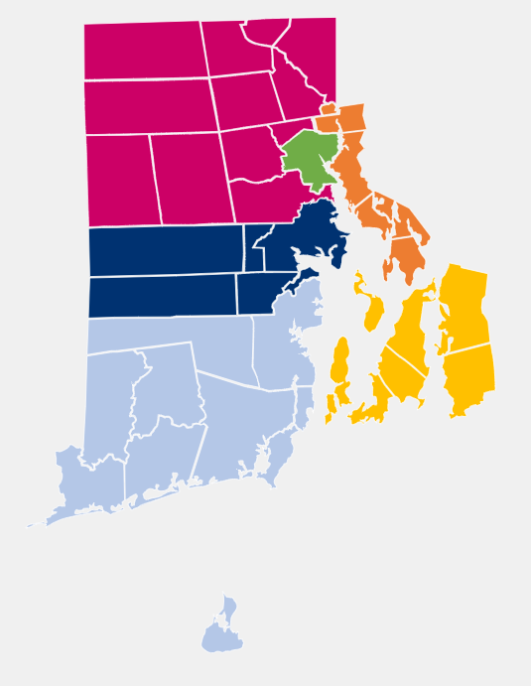
RI REGIONAL SHIP AGENCIES | TOWNS COVERED | PHONE NUMBER
Tri-County Community Action Agency - North | Cranston, Scituate, Cumberland, Johnston, Lincoln, North Providence, Burrillville, Foster, Glocester, North Smithfield, Smithfield, Woonsocket | 401-349-5760
Westbay Community Action Agency | Coventry, West Greenwich, East Greenwich, Warwick, and West Warwick | 401-921-5118
Tri-County Community Action Agency – South | Charlestown, Exeter, Hopkinton, New Shoreham, Richmond, North Kingstown, South Kingstown, Narragansett, and Westerly | 401-789-3016 ext. 3
United Way of Rhode Island | Providence | 401-519-0360
Diocese of Providence | Providence | 401-278-2514
East Bay Community Action Agency | Bristol, Barrington, East Providence, Warren, Pawtucket, and Central Falls | 401-435-7876
Child & Family Services of Newport County | Newport, Middletown, Portsmouth, Tiverton, Jamestown, and Little Compton | 401-848-4185
network partners are in your community
Rhode Island’s healthy aging help desk can be reached 24/7 by calling 401-462-4444
This project was supported, in part by grant number 90SAPG0073-01-00, from the U.S. Administration for Community Living, Department of Health and Human Services, Washington, D.C. 20201

