Slide 1
Entering MIPPA-Qualifying Beneficiary Contacts in STARS
Ginny Paulson, SHIP TA Center
2/21/2020

Slide 2


Today’s Audience
State Health Insurance Assistance Program
MIPPA
Medicare Improvements for Patients and Providers Act
SHIP
Administration for Community Living (ACL)
Notes:
SUE
Hello to the MIPPA and SHIP grantees in our audience today! We know that many of you are wearing both a MIPPA and a SHIP hat and using STARS to report your efforts.
This webinar is being recorded, and the recording will be available in the STARS Resources Kit, featured in the SHIP Resource Library, by the end of the day tomorrow. The PPT is already available in the library and will be available for download at the end of today’s presentation. Resources will also be emailed to the MIPPA listserv.

Slide 3
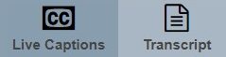
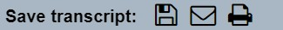
Closed Captioning for This Event
Live Captions
Provides closed captioning starting from the moment you click the link provided in WebEx Chat.
Transcript
Provides the full transcript from the start of the call up until the time you click on the Transcript tab.
Notes:
SUE
Closed captioning is available for today’s event. The link to access the closed captioning is provided in the WebEx chat.
When you click the link, you’ll see the “Live Captions” tab, which provides closed captioning starting from the moment you click the link. The Transcript tab provides the full transcript from the start of the call up until the time you click on the Transcript tab. The PowerPoint presentation and a handouts are already available in the library now. The recording will be posted by the end of the day tomorrow.

Slide 4


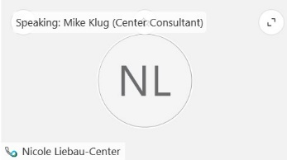

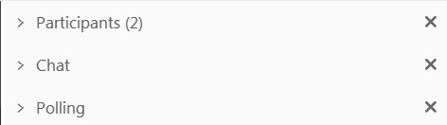

WebEx functionality
2
The view icon in the upper right corner changes your view in WebEx.
  Tip: Select the middle option so you can see who’s speaking!
The toolbar on the left side of the screen allows you to zoom in and out to show a closer or farther out view of the PowerPoint presentation.
The menu at the bottom allows you to mute your line, open the participants and chat panels, and leave the event.
The panels on the right show participant information, chat, and polling (when in use). Use the arrow and x to open and close the panels.
    Tip: To raise your hand, open the participant panel and click the hand icon in the lower right corner.
1
3
4
Notes:
SUE
Today’s webinar, and all of the Center’s remote training sessions and meetings, use a web conferencing software called
WebEx. Before we get started with today’s orientation, I’d like to make sure you’re all familiar with how to use the WebEx software.
Point out zoom in/out button on the left.

Slide 5
Agenda
Overview
  MIPPA Performance Measures Impacted by Beneficiary Contacts in STARS
  MIPPA-Qualifying Topics Discussed
  Data entry checklist
STARS Demonstration
  Beneficiary Contact Form (BCF)
  Beneficiary Additional Sessions (BAS)
Resources
Questions
Notes:
Lauren.

Slide 6
Overview

Slide 7
MIPPA Performance Measures
PM1: Overall MIPPA Contacts
Percentage of total beneficiary contact forms per Medicare beneficiaries under 150% FPL in the State
PM2: Overall Persons Reached through Outreach
Total number of people reached as reported on group outreach and education forms
PM3: MIPPA Target Populations
Total number of beneficiary contact forms by target beneficiary groups (Under 65, Rural, Native American, English as a Secondary Language)
PM4: Contacts with Applications Submitted
Percentage of forms with applications submitted compared to overall MIPPA contacts reported in PM1
Notes:
MIPPA Performance Measures 1, 3, and 4 come from the Beneficiary Contact Forms and Beneficiary Additional Sessions Forms

Slide 8
MIPPA-Qualifying Topics Discussed
MIPPA-Qualifying Answer Options on BCF/BAS by Topic Category
Part D Low Income Subsidy (LIS/Extra Help) | Medicaid | Additional Topic Details
Application Assistance | Application Submission (Check this for MSP Application Submission) | Preventive Services
Application Submission | Benefit Explanation
Benefit Explanation | Eligibility/Screening
Eligibility/Screening | Medicaid Application Assistance
LI NET/BAE | Medicare Buy-In Coordination
 | MSP Application Assistance
 | Recertification
Notes:
BCF stands for Beneficiary Contact Form. BAS stands for Beneficiary Additional Sessions form.

Slide 9
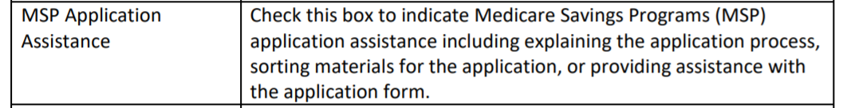
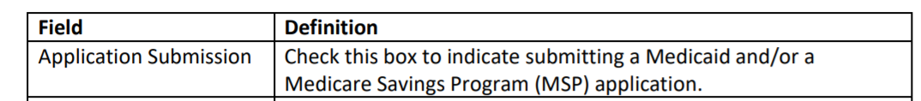
FAQ: How Do I Document MSP Application Assistance and MSP Application Submission?
Use Medicaid “Topics Discussed" category
Use MSP Application Assistance
Use Application Submission
  Includes MSP applications
Notes:
This has become a frequently asked question. Excerpted here are the definitions from the manual, Chapter 4 (Beneficiary Contacts). I will show you the data entry fields during the demonstration. ACL realizes this is not as intuitive as desired. A future enhancement in STARS is planned.

Slide 10
MIPPA BCF/BAS Data Entry Checklist
“Session Conducted By” a MIPPA Team Member?
  “MIPPA” must be checked for “Program” on that Team Member’s record
MIPPA Yes/No? Must be yes
Topics Discussed? At least one MIPPA-qualifying
Hard to Reach (PM3 – Beneficiary Contacts)?
  Under 65 and receiving/applying for disability benefits, or
  Beneficiary Race (Native American – two options), or
  Rural (zip code-based), or
  English as a Primary Language = No
Application Submission (PM4)?
  Topics Discussed > Part D Low Income Subsidy (LIS/Extra Help) > Application Submission, or
  Topics Discussed > Medicaid > Application Submission or Recertification

Slide 11
STARS Demonstration
Entering a MIPPA-Qualifying Beneficiary Contact
Notes:
Slides about the location of MIPPA Performance Measures Data in STARS are the Appendix to this PPT. In today’s webinar, that same material will be covered in a live demonstration.

Slide 12
STARS Resources
Webinars
Manual
Job Aids
Notes:
Ginny

Slide 13
New MIPPA STARS Handouts
MIPPA & STARS: At-a-Glance Reference
  Chart about PMs regarding beneficiary contacts
  MIPPA Qualifying Topics and Definitions for beneficiary contacts (excerpted from STARS Manual)
  Rural definition
MIPPA BCF/BAS Data Entry Checklist
  Excerpted from today’s PPT
Definition of Rural
  Excerpt from today’s PPT and sample PM 3 report
Today’s PPT (PowerPoint)

Slide 14

STARS Manual and Other Resources
STARS Manual:
Chapter 1: Introduction
Chapter 2: User Basics
Chapter 3: Team Member Management
Chapter 4: Beneficiary Contacts
Chapter 5: Group and Media Outreach and Education
Handouts, Job Aids and PowerPoints about:
Searches
Reports
User roles
Recordings of past data entry trainings
Notes:
Chapter 1 covers: Programs that use STARS; Data entry due dates; How to get resources and technical assistance.
Chapter 2 covers: STARS address/landing page; Credentials (usernames and passwords); STARS security; STARS inactivity rules; Entering hours on your own team member form
Chapter 3 covers: Creating and Managing Team Members; Using the Activity Form; CMS SHIP Unique ID; Detailed user role descriptions and the impact of the STARS hierarchy
Chapter 4 covers: Beneficiary Contact Form and the Beneficiary Additional Sessions Form
Chapter 5 covers: Group outreach and education (GOE) and media outreach and education (MOE) forms
Use the job aids, handouts, and PPTs for searches, reports, and user role overview.

Slide 15
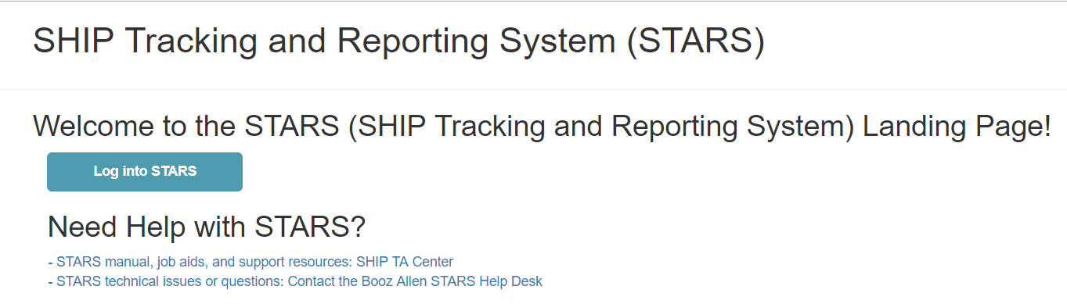
STARS Landing Page
https://stars.acl.gov
Contains link to SHIP TA Center’s STARS Resources page
Contains link to Booz Allen STARS Help Desk
Notes:
Anyone with the link can visit the STARS landing page. BUT, only users with credentials can successfully log in.

Slide 16
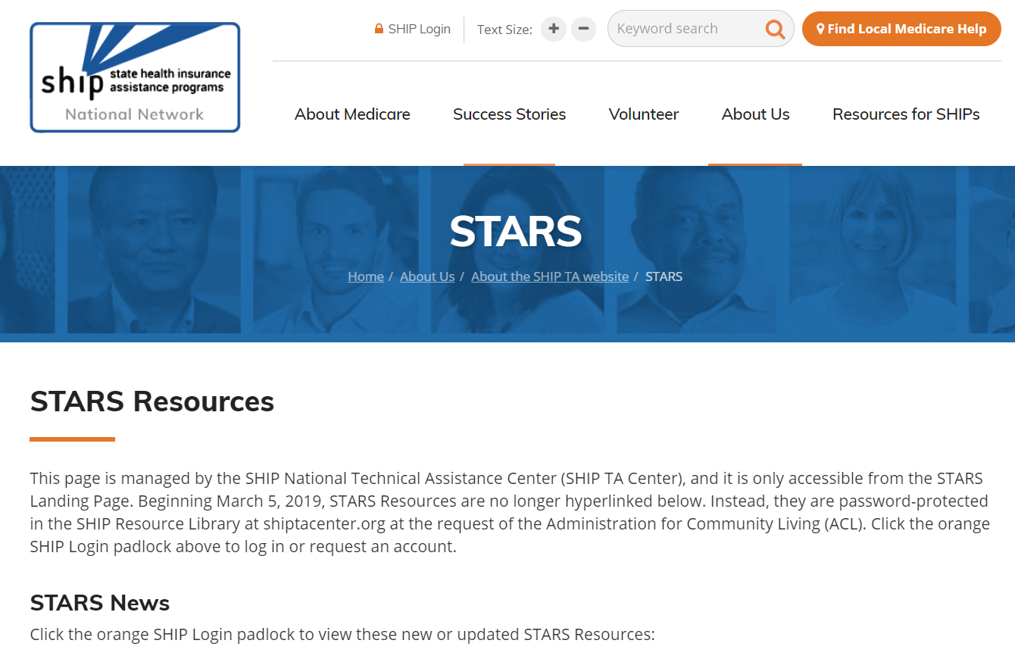
STARS Resources Page
Notes:
SHIP directors and SHIP administrators approve accounts to log into

Slide 17
Individualized Technical Assistance
For STARS technical assistance, contact the STARS help desk at Booz Allen Hamilton:
  boozallenstarshelpdesk@bah.com or 703-377-4424
For questions about job aids and other STARS support resources, contact the SHIP TA Center:
  stars@shiptacenter.org or 877-839-2675
For assistance accessing the SHIP TA Center’s password-protected Resource Library, contact:
  info@shiptacenter.org or 877-839-2675

Slide 18
Panelist Contacts
Maggie Flowers, ACL’s SHIP and MIPPA Program Manager
  202-795-7315; Margaret.flowers@acl.hhs.gov
Ginny Paulson, SHIP TA Center Director
  319-358-9402; gpaulson@shiptacenter.org
Dennis Smithe, SHIP TA Center Program Development Manager
  877-839-2675; dsmithe@shiptacenter.org

Slide 19
Questions?
Move your mouse around the bottom of your screen to activate chat. Click the blue CHAT bubble at the bottom of your screen.
Notes:
SUE
How to Chat
I’ll be putting up some files you can transfer to your computer, while you are thinking of questions.
Once you download the files (if you want to), you can stick around to listen and ask questions, or you are free to leave the webinar.

Slide 20

Webinar Resources in the Library
Step 1: Login at www.shiptacenter.org (click the orange SHIP Login padlock).
Step 2: Go to the Resource Library and view “Recent” or go to the STARS Resources Kit under “Featured”
20
Notes:
SUE The PowerPoint and other webinar resources for today’s event are already available in the SHIP Resource Libraries. The recording of today’s webinar will be available in the library by the end of the day tomorrow.

Slide 21

Thank you for participating!
Today’s webinar materials are available for download within WebEx, and the recording will be in the SHIP Resource Library tomorrow.
This event was supported, in part, by grant number 90SATC0001 from the Administration for Community Living (ACL), Department of Health and Human Services, Washington, D.C. 20201.
Notes:
SUE

Slide 22
Appendix
Location of MIPPA Performance Measures Data in STARS
Notes:
The following slides are excerpted from previous webinars about the MIPPA Performance Measures. They are included here for your reference.

Slide 23
PM1: Overall MIPPA Contacts
Percentage of total beneficiary contact forms per Medicare beneficiaries under 150% FPL in the State
MIPPA Performance Measure 1 Overview
Beneficiary Contact forms with at least one of the subtopic options (listed in chart below) selected from: Part D Low Income Subsidy (LIS/Extra Help) Topics Discussed; OR Medicaid Topics Discussed; OR Preventive Services selected from the Additional Topic Details NOTE: The contact form may have multiple Topics Discussed selected, but will only count for one contact.
Denominator Data Source: Low-income: LIS beneficiary population (CMS data)
At Least One of the Following Topics Discussed Options Must be Selected
Part D Low Income Subsidy (LIS/Extra Help) | Medicaid | Additional Topic Details
Application Assistance | Application Submission | Preventive Services
Application Submission | Benefit Explanation
Benefit Explanation | Buy-in Coordination
Eligibility/Screening | Eligibility/Screening
LI NET/BAE | Medicaid Application Assistance
 | MSP Application Assistance
 | Recertification
OR
OR
Notes:
- IF they’re helping with redetermination paperwork to help a bene keep LIS, they’d just note it as Application Submission
- include additional beneficiary session forms when available

Slide 24
PM2: Overall Persons Reached through Outreach
Total number of people reached as reported on group outreach and education forms
MIPPA Performance Measure 2 Overview
Group Outreach forms with the following criteria: At least one Target Beneficiary Group options on the chart below selected; AND At least one Topics Discussed options on the chart below selected
Target Beneficiary Group Options | Topics Discussed Options
Low Income | Extra Help/LIS
Rural | Medicaid
 | MSP
 | Preventive Services
AND
Notes:
Rural is defined by the person inputting the data not by zip code
Sum of Group Outreach forms with qualifying criteria. Penetration Rate will not be applicable for this PM

Slide 25
PM3: MIPPA Target Populations
Total number of beneficiary contact forms by target beneficiary groups (Under 65, Rural, Native American, English as a Secondary Language)
MIPPA Performance Measure 3 Overview
Beneficiary contact forms with the following criteria: One of the Target Beneficiary Groups: Beneficiaries Under 65, Rural Beneficiaries, Native American Beneficiaries, or Beneficiaries with English as Secondary Language AND At least one Topics Discussed options listed in the chart below selected
At Least One of the Following Topics Discussed Options Must be Selected
Part D Low Income Subsidy (LIS/Extra Help) | Medicaid | Additional Topic Details
Application Assistance | Application Submission | Preventive Services
Application Submission | Benefit Explanation
Benefit Explanation | Buy-in Coordination
Eligibility/Screening | Eligibility/Screening
LI NET/BAE | Medicaid Application Assistance
 | MSP Application Assistance
 | Recertification
OR
OR
Notes:
We will report by group, not rolled up, and report by counts which can be compared across years
We explored MIPPA ADRC Part D but based on the way the legislation is written we feel would only be counted if someone was also assisted with LIS which is captured here.
Added non-native English speakers

Slide 26
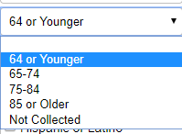
PM3: MIPPA Target Populations –
Beneficiaries Under 65
Includes contacts with anyone who is under 65 and:
  Receiving or applying for Medicare and Social Security benefits due to disability
To count toward PM 3 requires selection of both fields 64 or Younger and Yes

Slide 27
PM3: MIPPA Target Populations –
Rural Beneficiaries
Contacts with beneficiaries whose zip code is located in county classified in a nonmetropolitan category
  Centers for Disease Control National Center for Health Statistics (NCHS) Urban-Rural Classification Scheme
    6 levels (slices) previously used: large central metro, large fringe metro, medium metro, small metro, micropolitan, noncore (aka outside)
    2 of 6 = Rural
      Micropolitan (MIC): 10,000 – 49,000
      Outside (OUT): noncore
Same rural definition as SHIP PM4
Notes:
The Metropolitan and Micropolitan statistical areas are geographic areas delineated by the County classifications are designated by the Centers for Disease Control National Center for Health Statistics. These are the same definition CMS used.
Each area consists of one or more counties and includes the counties containing the core urban area and any adjacent counties that have a high degree of social and economic integration.

Slide 28
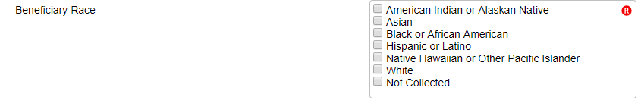
PM3: MIPPA Target Populations –
Native American Beneficiaries
Includes contacts with anyone who selects one of the following:
  American Indian or Alaskan Native, or
  Native Hawaiian or Other Pacific Islander

Slide 29
PM3: MIPPA Target Populations –
Beneficiaries with English as a Secondary Language
A client should be considered a Beneficiary with English as a Secondary Language if (a) they answer “no” to “Is English your first language?“ or (b) if the counselor can reasonably conclude that the client is not fluent in understanding, speaking, reading, and/or writing the English language.

Slide 30
PM4: Contacts with Applications Submitted
Percentage of forms with applications submitted compared to overall MIPPA contacts reported in PM1
MIPPA Performance Measure 4 Overview
Beneficiary Contact forms with at least one of the subtopic options (listed in chart below) selected from: Part D Low Income Subsidy (LIS/Extra Help) Topics Discussed, OR Medicaid Topics Discussed
At Least One of the Following Topics Discussed Options Must be Selected
Part D Low Income Subsidy (LIS/Extra Help) | Medicaid
Application Submission | Application Submission
 | Recertification
OR
Notes:
Part D Low Income Subsidy (LIS/Extra Help) - Application Submission
Report LIS Redeterminations as LIS Application Submission since there is no separate field for it in STARS
Medicaid - Application Submission, Recertification
Report MSP Application Submission as Medicaid Application Submission since there is no separate field for it in STARS

