Slide 1
Entering PDP and MA-PD Cost Changes into STARS
-Melissa Simpson, ACL
-Ginny Paulson, SHIP TA Center
September 2020
Notes:
Sue. Welcome to today’s webinar! Our content for today is intended for the SHIP network. In this webinar, you will learn how to accurately enter cost change information on the beneficiary contact form into STARS. You will also learn what documentation is required and how to properly provide that documentation. We are in broadcast mode. We will pause for selected questions after the demonstration and we will also take questions at the end. The PowerPoint and handouts are already in the Resource Library. They will also be made available for download within Webex at the end of the webinar today.

Slide 2
Agenda
ACL Guidance on Part D Enrollment Outcomes Tracking
STARS Security
Demonstration
Data Accuracy Pointers
STARS Resources
Questions
Notes:
Sue

Slide 3
Polling
Have you been to previous webinar training about entering Part D cost changes in STARS?
Have you seen the STARS Manual?
Have you seen the PDP/MA-PD Cost Reporting Job Aid?
Notes:
Sue’s slide. Answer options are yes or no.

Slide 4
Today’s Focus
Yes: Beneficiary contacts with Part D enrollment
outcomes (includes both PDP and MA-PD)
  Any kind of SHIP Beneficiary Contact? No.
    Covered in August 2020 webinar (see STARS Resources Kit)
  MIPPA Beneficiary Contacts? No.
    Covered in February 2020 webinar (see STARS Resources Kit)
Notes:
Sue

Slide 5
Tracking Part D Enrollment Outcomes
Melissa Simpson, ACL
Notes:
Sue pass the ball to Melissa on this slide

Slide 6
Overview
ACL uses STARS to collect data related to the cost changes as result of enrollment in Part D prescription drug plans (PDPs) and Medicare Advantage plans with prescription drug coverage (MA-PDs) available through the Medicare Plan Finder (MPF).
By collecting this data, SHIPs can demonstrate the impact of their work on behalf of beneficiaries in three ways:
Data on the number of beneficiaries who received PDP/MA-PD enrollment assistance from SHIPs;
Data on the average cost change per beneficiary who received PDP/MA-PD enrollment assistance from SHIPs;
Data on the reported total of PDP/MA-PD cost change for each state.

Slide 7
Part D/MA-PD Enrollment Data Steps
1. Collect Plan Cost Information
2. Assist Beneficiary with Enrollment
3. Enter Data in STARS
4. Attach Verification
Notes:
If you’re reporting cost change data, these are the steps to follow.
Talk through steps
IMPORTANT NOTE: Special Use Fields and File Upload/Attachments are not available in the Additional Sessions Tab. When reporting cost change data, edit the initial form and resave to add details.

Slide 8
Step 1: Collect PDP/MA-PD Cost Data
Track when you actively assist a beneficiary with PDP/MA-PD enrollment*
  Online through the MPF or the plan website, or
  Over the phone with a plan customer service representative or 1-800-Medicare, or
  With a paper application
Two kinds of enrollment
  Switching from one plan to another
  New to Medicare PDP/MA-PD
*Cost changes resulting from any action outside PDP/MA-PD are important and not part of the Enrollment Outcomes tracking. Examples may include change in pharmacy, applications for Part D subsidies like Extra Help/LIS, State Pharmaceutical Assistance Program (SPAP), or drug manufacturer discount programs.

Slide 9
When using the Medicare Plan Finder (MPF)
Three data components are needed:
Original cost
New cost
Application confirmation
URL: https://www.medicare.gov/find-a-plan/

Slide 10
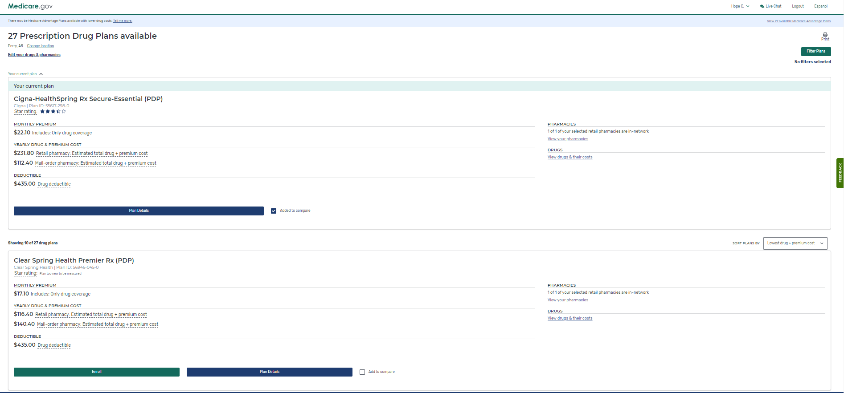
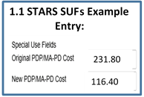
MPF - Switching Plans (Original vs. New Costs)
Pharmacy
Original Cost SUF 1 $231.80
New Cost SUF 2 $116.40
Notes:
The beneficiary’s current plan appears first in the list as Your current plan. (During the Open Enrollment Period the text display is “Your next plan (if you don’t change)”), highlighted with red arrow below. If the beneficiary stays in this plan, their estimated total drug + premium cost is $231.80 at the retail pharmacy of their choice, highlighted with a red star. The beneficiary decides to enroll in the Clear Spring lower cost plan estimated total drug + premium cost of $116.40, highlighted with a red moon.
IMPORTANT: To capture cost data, select only one retail pharmacy to view the drug cost + premium on the comparison summary page pictured below. If more than one pharmacy is selected, the drug + premium cost shows for the lowest cost pharmacy of those selected for comparison.

Slide 11
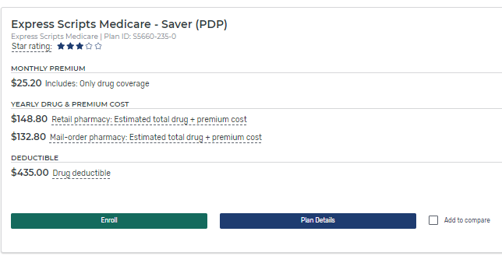
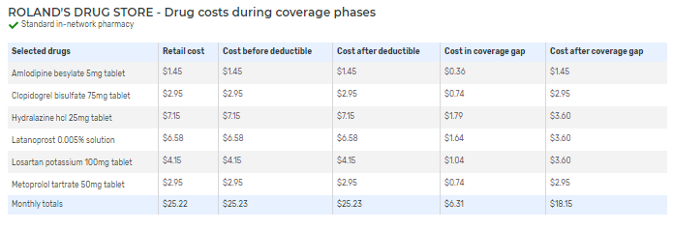
MPF – New to Medicare (Original Cost Calculation)
Click Plan Details and scroll to cost at beneficiary’s pharmacy
$25.22 X 12 months = $302.64
Notes:
The beneficiary wants to enroll in the Express Scripts Medicare-Saver (PDP) with an estimated total drug + premium cost of $148.80 at the pharmacy of their choice, highlighted with a red star.

Slide 12
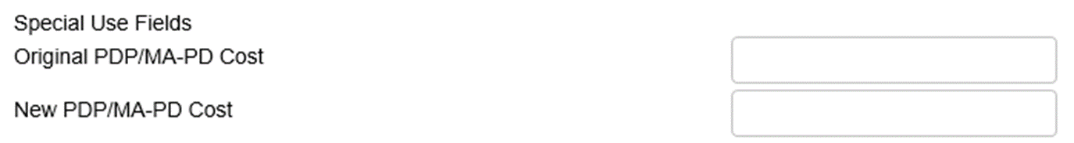

MPF – New to Medicare (New Costs)
New Cost SUF 2 $148.80
1.2 STARS SUF Example Entry:
302.64
148.80
Notes:
The beneficiary wants to enroll in the Express Scripts Medicare-Saver (PDP) with an estimated total drug + premium cost of $148.80 at the pharmacy of their choice, highlighted with a red star.

Slide 13
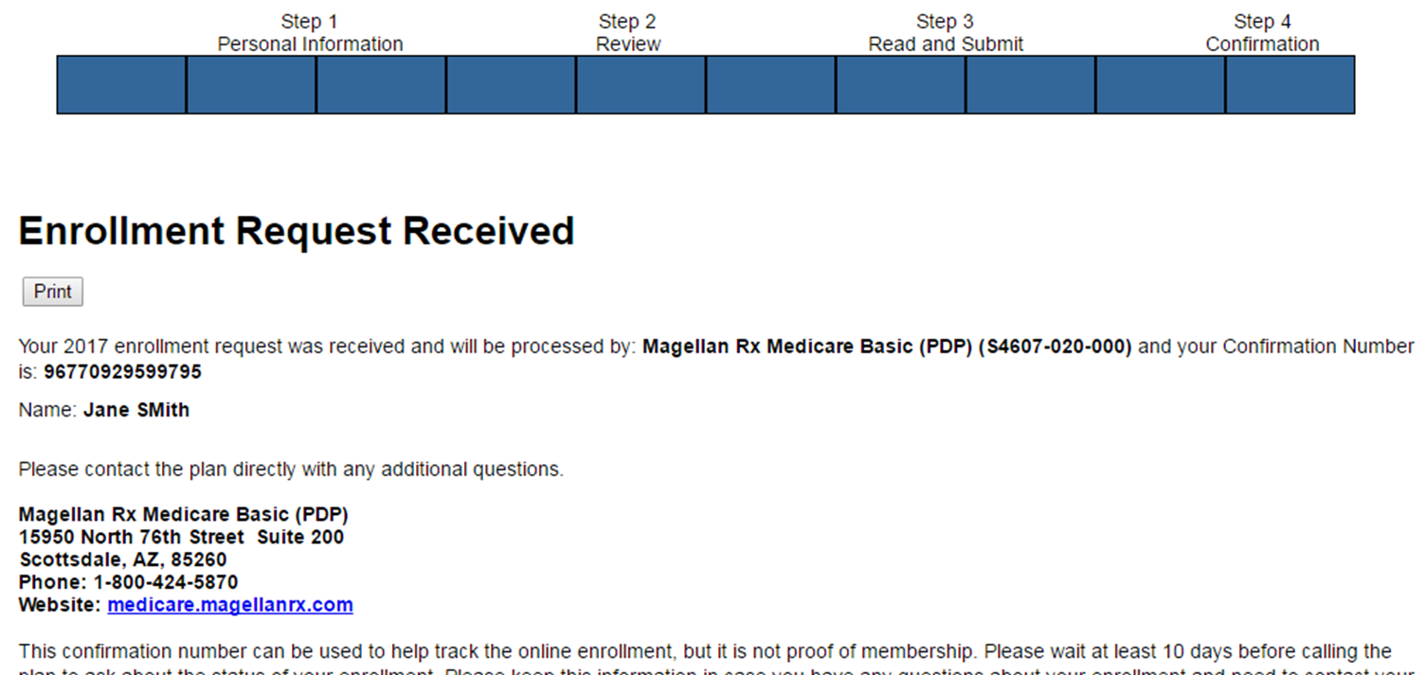
Step 2: Assist with Enrollment and Save Application Confirmation
If enrolling by another method (plan’s website, phone, etc.) an enrollment confirmation information must be saved.
If using MPF, upload the MFP application confirmation
New Part D/MAPD (future)
Notes:
If using the plan’s website, calling the plan, or some other alternative for Part D enrollment, the SHIP team member must have an application confirmation and upload it into STARS.
The Application confirmation from the Medicare Plan Finder does include PHI. Remember, STARS meets the FISMA moderate category for the federal government security requirements. Alternatives to avoid uploading PHI:
Add a colored box over the bene name when saving the document
Print and mark over the name before scanning and uploading the document.
Some counselors asked whether they should save these documents for uploading on a public computer, say at a library. If so, be sure to see the STARS security slick sheet for tips to delete files. Or keep a password protected USB (thumb) drive handy and save them there for uploading.

Slide 14
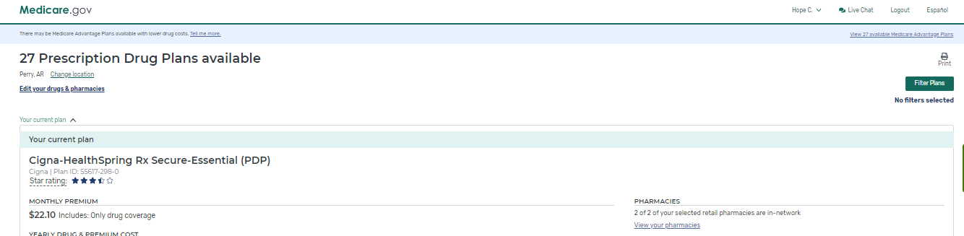
Printing Tips for the MPF – Step 1
At the top of every page there is an option to print the page

Slide 15
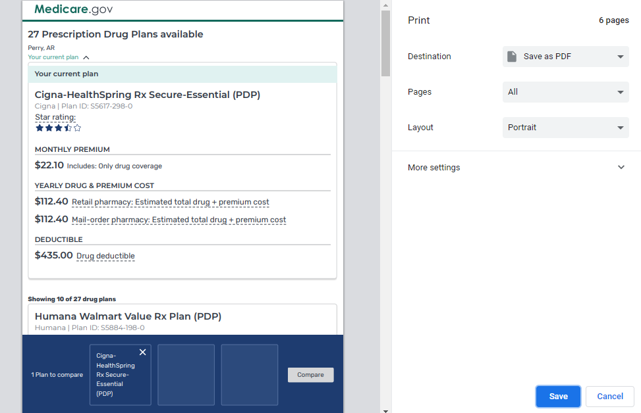
Printing Tips for the MPF – Step 2
You will be taken to a new window and the print options will appear.
If “Print to PDF” is an option and is selected, you will be able to save a PDF version of the Plan Finder page on your computer.

Slide 16
Print using your keyboard
This is called a “Screen shot”
Press the “Ctrl” key, hold it down, press the “PrtScn” key
The image is now copied to your computer’s clipboard.
Open a Word document
Paste the image into the document
  Keyboard shortcut: press the “Ctrl” key, hold it down, press the “V” key
Save the document

Slide 17

Snipping Tool – Built into Many Computers
  Go to: Start menu > All Programs > Windows Accessories > Snipping Tool, OR, type “Snip” in the Windows Search bar in the bottom left corner of your screen:
  Open the snipping tool and click New (has a scissor icon).
  Your mouse will become “+” shaped
  Drag the + with your cursor to define your print area.
  When you let go, the image will appear in a new window.
  Save it (such as by clicking the disk icon).
  Follow the prompts to save it to your computer.
Notes:
Security Reminder: If you’re saving Medicare Plan Finder data on a public computer, reference the STARS Security Slick Sheet for tips on how to delete files. Alternatively, use a password protected USB (thumb) drive handy and save them there to attach to BCFs later.

Slide 18
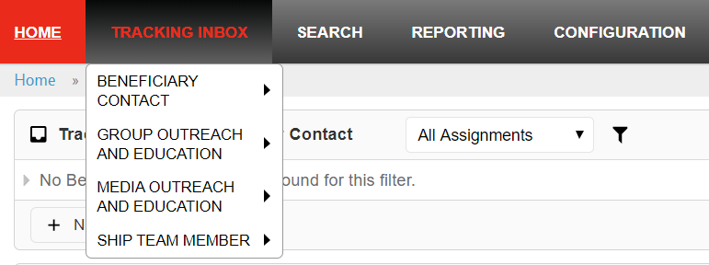
Step 3 – Enter Data in STARS
All Part D cost changes are entered on the Beneficiary Contact Form (BCF) in the Tracking Inbox
Notes:
If you have attended basic training the STARS beneficiary contact form, you should be familiar with the Tracking Inbox and Beneficiary Contact Form.

Slide 19

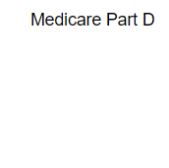
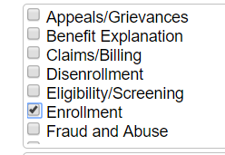
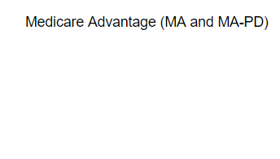
“Enrollment” Topic Discussed
Topic Discussed: “Medicare Part D” category or “Medicare Advantage (MA and MA-PD)” category
  Check “Enrollment” in one category (not both) to report enrollment assistance (pictured below).

Slide 20
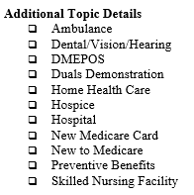
New to Part D (PDP or MA-PD)?
Topics Discussed: “Additional Topic Details” category
  Select “New to Medicare”
    even if the beneficiary has been enrolled in other parts of Medicare previously

Slide 21
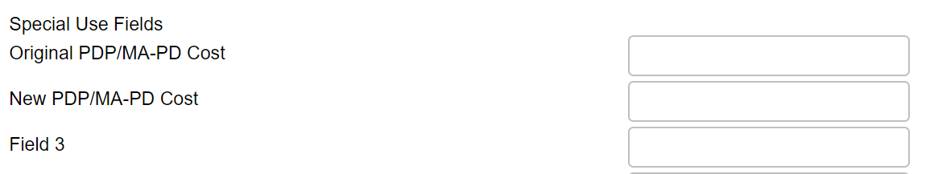
Original vs. New PDP/MA-PD Cost
The first two Special Use Fields (SUFs) on the BCF are designated (Original and New).
Enter only numbers or currency symbols (dollar sign, comma, or decimal points)

Slide 22
Original vs. New – Two Examples
Examples based on our previous slides are compared here:
Currently, there is no calculation of the cost change on the BCF or elsewhere in STARS
Calculations of cost changes will occur in a future STARS report.
1.2 New to Medicare PDP/MA-PD
231.80
302.64
116.40
148.80

Slide 23

Step 4: Attach Cost Verification Sources
Attach the following verification to the Beneficiary Contact Form:
  Application confirmation
  Cost changes verification detailing Original and New Cost
File types accepted: pdf, png, jpeg, rtf, doc/docx; ppt/pptx; xls/xlxs, m4a, csv, html, xml, bmp
File size limit: 500MB per file.
Notes:
The cost data reported for PDP/MA-PD enrollment must be auditable for ACL to verify and share the numbers reported. Therefore, for SHIPs to accurately report this element, ACL requires supporting documentation when cost change data are reported in the Special Use Fields (SUFs) 1 and 2. Cost change supporting verification should be attached to the Beneficiary Contact Form (BCF) or stored in electronic or paper files accessible for future quality assurance audits. ACL and SHIPs will periodically review reported cost change data and move it to the notes field if it lacks required verification (remainder of Beneficiary Contact Form will be unchanged).
There are several reasons a beneficiary might enroll in a plan outside of cost considerations, like coverage or convenience. ACL collects cost change data on all PDP/MA-PD enrollments, including those that do not results in savings for the beneficiary.

Slide 24
STARS Security
Federal Information Security Management Act (FISMA) moderate
  Data encrypted during API transfer
  Data encrypted in STARS
  Password requirements
    Valid for 90 days
Notes:
The Federal Information Security Management Act of 2002 addresses the importance of information security to the economic and national security interests of the US. The act requires each federal agency to develop, document, and implement an agency-wide program to provide security for the information and information systems, like STARS, that support the operations and assets of the agency. This includes those provided or managed by another agency, contractor, or other source, like Booz Allen Hamilton does on behalf of ACL.
There are several FISMA categories. STARS is the FISMA category known as moderate.

Slide 25
PII and PHI
Personally Identifiable Information (PII) | Protected Health Information (PHI)
Information which can be used to distinguish or trace an individual’s identity, such as their name, social security number, biometric records, etc. alone or when combined with other personal or identifying information which is linked or linkable to a specific individual, such as a data and place of birth, mother’s maiden name, etc.”¹ | Individually identifiable health information that is explicitly linked to a particular individual, and health information which can allow individual identification.² PHI includes many common identifiers (e.g., name, address, birth date, Social Security Number) when they can be associated with the health information listed above.
OMB M-07-16 Memo Safeguarding Against and Responding to the Breach of Personally Identifiable Information
Health Insurance Portability and Accountability Act of 1996 website
Notes:
In conducting SHIP work, we collect both Personally Identifiable Information and Protected Health Information. The biggest differences between the two items are:
PII is ANY potentially identifying either on it’s own or when combined with other information = most of information in STARS. STARS is built to house this information securely
PHI is HEALTH information and specifically identifies a person. This sometimes entered in notes/comment field. STARS is built to house this information securely, exercise caution and only enter when necessary or requested.

Slide 26
Tips for Handling Sensitive Data
Use private spaces to ensure sensitive data is safeguarded
Store all hard copies securely in locked filing cabinets or offices with a maintained filing system
Password protect electronic formatted documents and equipment (phones, computers, USB drives)
Do not leave files of documents with PII on desks, printers, personal computers, phones or other devices
Send and forward only encrypted emails with PII
Clear web browser history
Disable auto-fill on web browser

Slide 27
Records Retention Requirements
Grantee record retention policy
  Applies to all ACL grants
  Retain all documentation for a grant for a minimum of three (3) years after the submission of the final report
  SHIP Grant Example
    Grant ending 3/31/2020
    Final report due on 7/1/2020
    Maintain grant documentation to 7/1/2023

Slide 28
Part D Enrollment Outcomes and quality assurance Reports

Slide 29
Enrollment Outcomes Reports in 2021
Two reports
  Quality Assurance
    Incomplete records for further review
    Valid records documentation verification checks
  Enrollment Outcomes Aggregate Reports
    National
    State/Substate/Site
    Team member

Slide 30
STARS Demonstration
Ginny Paulson, SHIP TA Center
Notes:
Ginny

Slide 31
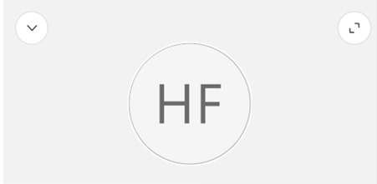

Demonstration Viewing Tips
During the demo, a gray box may appear on your screen with your initials.
You can:
Close the box by clicking the arrow in the upper left corner of the box.
Grab the box and move it out of the way.
Click the “Escape” key on your keyboard to show the panels on the right instead.
Notes:
Ginny:

Slide 32
Data Accuracy Pointers

Slide 33
Part D Enrollment Outcomes Accuracy Checklist
Topics Discussed
Check Enrollment in either (not both) the “Medicare Part D” or “Medicare Advantage (MA and MA-PD)” category
If the beneficiary is new to PDP/MA-PD, select the New to Medicare topic in “Additional Topic Details” category
Special Use Field: Original PDP/MA-PD Cost
Enter the Estimated Drug Cost* of the plan the beneficiary’s current plan listed on MPF
If beneficiary has no current Medicare PDP/MA-PD plan, then enter the drug costs displayed for Original Medicare on MPF
New PDP/MA-PD Cost
Enter the Estimated Drug Cost* of the new plan the SHIP team member helped the beneficiary enroll in, as listed on the MPF
Attach Cost Verification
Notes:
When entering the cost data for the Part D plans the beneficiary’s current plan cost should be entered in the “Original PDP/MAPD Cost’ text box. If the beneficiary doesn’t have a plan or their plan is no longer available because it ended or they moved, use the cost associated with Original Medicare as if there were no drug coverage.
And, then enter the future plan cost entered in the “New PDP/MAPD Cost” box. This box is a text box and will accept whatever is entered so be sure to Double check the entry since it’s easy to add to many zeros or a keyboard button to stick.

Slide 34
Additional Resources for Accuracy and Security
STARS Manual, Chapter 4
See the Table of Contents to easily find (and hyperlink to) this topic
PDP/MA-PD Cost Reporting Job Aid
Same information as manual (chapter 4)
Privacy and confidentiality online course
Available in the password-protected OCCT (green button)
STARS Security Slick Sheet
STARS Resources Kit
Notes:
All of this is in the STARS Resources Kit, with the exception of the self-paced course in the OCCT

Slide 35
Accessing STARS Resources
Webinars
Manual
Job Aids
Notes:
Ginny

Slide 36
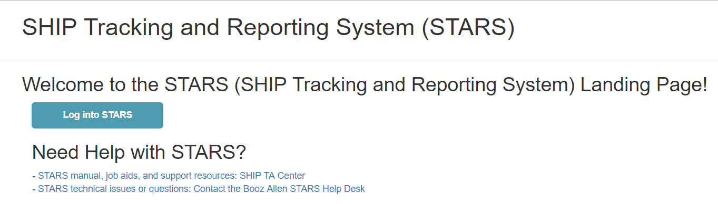
STARS Landing Page
https://stars.acl.gov
Contains link to SHIP TA Center’s STARS Resources page
Contains link to Booz Allen STARS Help Desk
Notes:
Anyone with the link can visit the STARS landing page. BUT, only users with credentials can successfully log in.

Slide 37
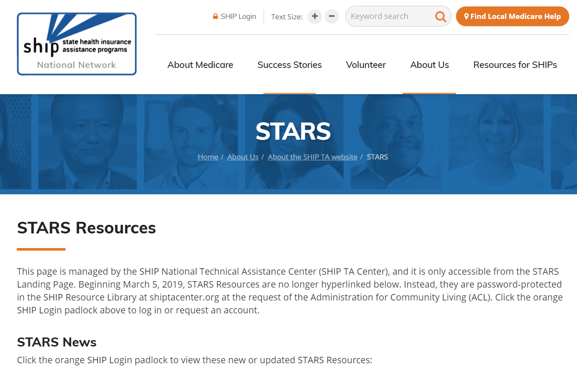
STARS Resources Page
Notes:
SHIP directors and SHIP administrators approve accounts to log into

Slide 38
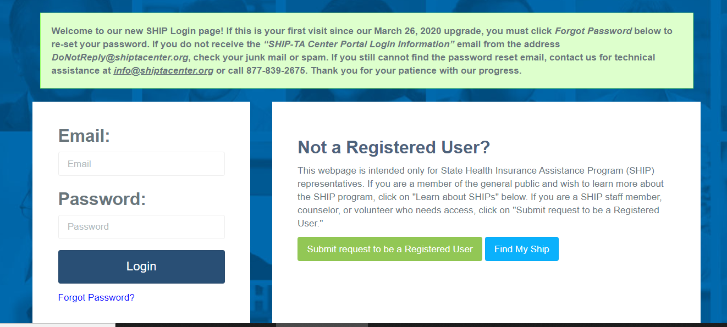
SHIP Login at www.shiptacenter.org
As of March 26, 2020, this is our login page.
  A green banner provides tips for first-time users

Slide 39
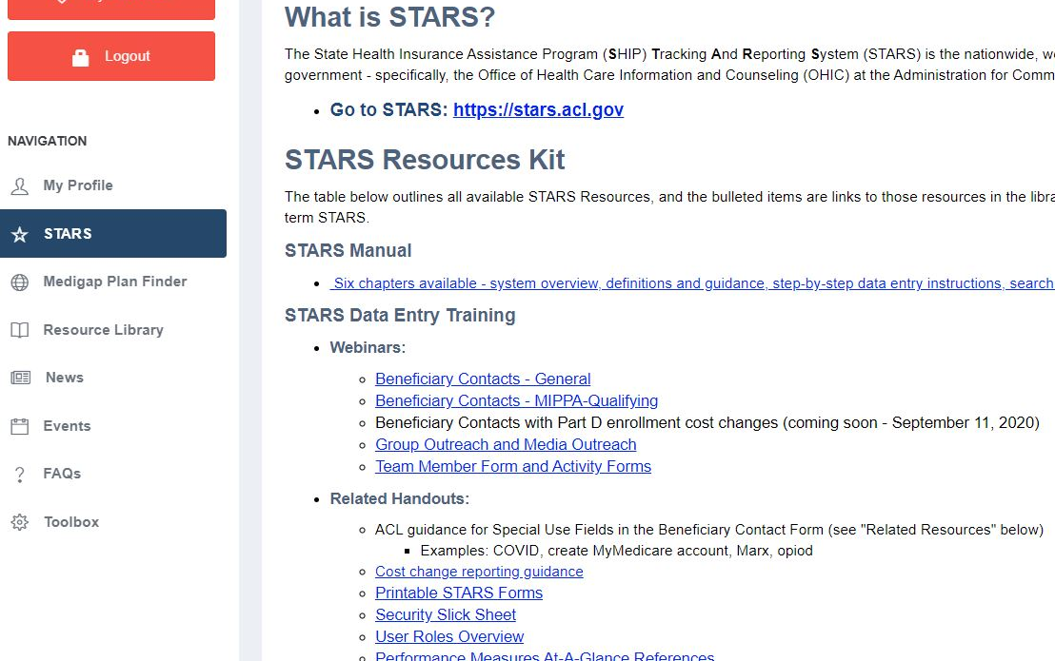
STARS Resources Kit in STARS Menu
Notes:
The STARS Resources Kit is now on this STARS menu. Directors and administrators control STARS resources visibility, including access to STARS events.

Slide 40

In the STARS Resources Kit
STARS Manual:
Chapter 1: Introduction
Chapter 2: User Basics
Chapter 3: Team Member Management
Chapter 4: Beneficiary Contacts
Chapter 5: Group and Media Outreach and Education
Chapter 6: STARS Searches
Handouts, Job Aids and Webinars about:
PDP/MA-PD Cost Reporting
Reports and Performance Measures
User roles
Data entry and search menu
Notes:
Chapter 1 covers: Programs that use STARS; Data entry due dates; How to get resources and technical assistance.
Chapter 2 covers: STARS address/landing page; Credentials (usernames and passwords); STARS security; STARS inactivity rules; Entering hours on your own team member form
Chapter 3 covers: Creating and Managing Team Members; Using the Activity Form; CMS SHIP Unique ID; Detailed user role descriptions and the impact of the STARS hierarchy
Chapter 4 covers: Beneficiary Contact Form and the Beneficiary Additional Sessions Form
Chapter 5 covers: Group outreach and education (GOE) and media outreach and education (MOE) forms
Chapter 6 covers: STARS Searches vs. STARS Reports, and how to conduct searches.
Use the job aids, handouts, and PPTs for searches, reports, and user role overview.

Slide 41
Individualized Technical Assistance
For STARS technical assistance, contact the STARS help desk at Booz Allen Hamilton:
  boozallenstarshelpdesk@bah.com or 703-377-4424
For questions about STARS training and resources, contact the SHIP TA Center:
  stars@shiptacenter.org or 877-839-2675
Today’s Speakers:
  Melissa Simpson: melissa.simpson@acl.hhs.gov
  Ginny Paulson: gpaulson@shiptacenter.org

Slide 42
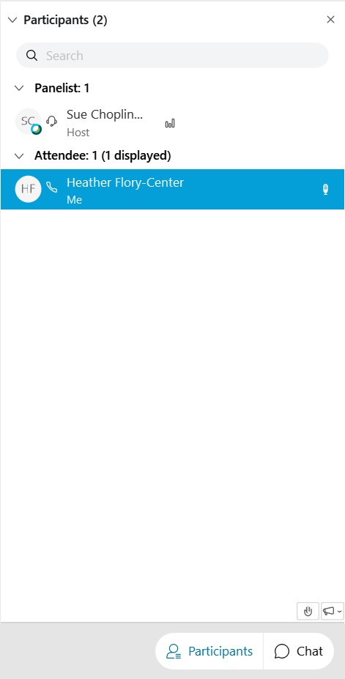
Questions?
Raise Hand
CHAT
Notes:
SUE
On the bottom right side of your screen, you will see how to Chat and raise your hand.
Today’s webinar materials are available for download within WebEx.

Slide 43
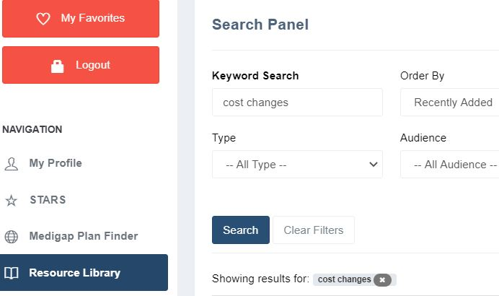
Today’s Resources
Available for file transfer in Webex
In the STARS menu, and
In the Resource Library
Recording added tomorrow
Notes:
Sue

Slide 44

Thank you for participating!
Today’s webinar materials are available for download within WebEx.
This webinar was supported, in part, by grant number 90SATC0002 from the U.S. Administration for Community Living, Department of Health and Human Services, Washington, D.C. 20201.
Notes:
Sue

