Slide 1

STARS Training: Entering Team members
April 24, 2018 – 2:00 pm Eastern Time
Notes:
Three job aids and today’s PPT are available for download until the official start time for today’s webinar. As a reminder, these materials are already posted on the STARS resources page. The address for that page is part of today’s training.

Slide 2
Agenda
Resources
Demo: Team Member Creation
STARS Basics
Q&A
Notes:
Hello everyone. I will provide an over of the STARS resources that are available, and then Scope: Today’s primary training objective is to explain and support data entry for team member creation. The SHIP NPR manual contains the program guidance for interpreting and entering SHIP activities into the national SHIP data reporting system. The definitions of terms, the SHIP performance measures, and the requirements about what types of activities are reportable is not changing.

Slide 3
STARS Resources
Webinars
Manual
Job Aids
Notes:
The SHIP TA Center is responsible for hosting webinars and creating job aids. ACL is updating the STARS manual based upon the former SHIP NPR manual. It will not be fully updated until mid-spring 2018. Meanwhile, users should rely on the SHIP NPR manual and leaders at your SHIP for guidance about definitions, terms, and reportable activities. Users should rely on STARS job aids and STARS training webinars for data entry instructions.

Slide 4
FAQs
Where do I get STARS Resources?
Who can access the STARS landing page, and when?
How can STARS users find out about upcoming training?
  ?
Notes:
At this early stage of the STARS roll-out, these are our most frequently asked questions.

Slide 5
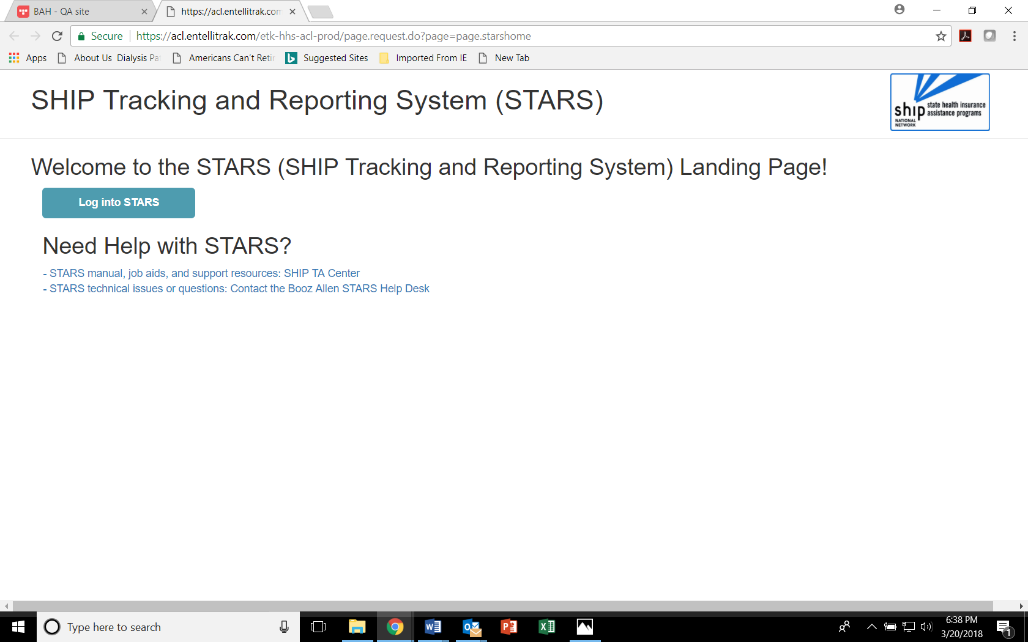
STARS Landing Page
https://stars.entellitrak.com
Contains link to SHIP TA Center STARS training materials (and, when it becomes available, ACL’s STARS manual)
Contains link to Booz Allen STARS Help Desk
Notes:
Anyone with the link can visit the STARS landing page now. BUT, only users with credentials can successfully log in. Anyone who visits this page WILL be able to follow the link to the STARS resources, however.

Slide 6

Job Aid Topics
STARS User Basics
  One for STARS Submitter role
  One for all other roles
Beneficiary Contact Form
Group Outreach and Education Form
Media Outreach and Education Form
Entering Team Members
STARS Launch
Reports, Searches, and Management Tools
Notes:
Topics in green are available now. They were either published or updated on April 12th. The content related to user role capabilities has been expanded or clarified. The Topic in orange will be published in conjunction with the June webinar on that topic. The bolded job aids in bold align with today’s topic and will be made available for download at the end of today’s webinar in addition to this PPPT.

Slide 7
Webinars – Past and Future
Future Webinars
  Registration forms emailed to SHIP director listserv and directly to director/administrator users at www.shiptacenter.org
Past webinars
  Recordings and PPT posted under “Need Help” on the STARS landing page
Collaborative Effort
End Users Satisfied
Notes:
During the STARS roll-out, our communication process is designed to place control in the hands of the SHIP leaders. Our goal is to ensure STARS users have the information they need without interfering or preempting state-specific roll-out procedures and information. The gradual roll-out process by SHIP group makes this particularly important. The varying needs of the varying STARS user roles is another factor. For example, users who are helping create team members may need to be given access to STARS earlier than other users. We’ll discuss STARS start dates shortly.

Slide 8
Webinar Series on Forms
Beneficiary Contact Form
(twice a month through October)
Group and Media Outreach Forms
(once a month through October)
About this series
Announced To date: April and May webinars
Intended Audience: STARS users invited by their SHIP leader, particularly past groups and the group preparing for their start date
Key point: SHIP activities should not be entered before STARS start date
Team Member Form
(once a month through July)
Notes:
You are attending the second Team Member webinar. It was first held in March, and it will be repeated in May, June, and July.

Slide 9
STARS Basics
Related to Team Member Creation
Notes:
Before we get into the demon

Slide 10
STARS User Essentials
1. Team Member Profile
2. Credentials (= Username + Password)
3. The STARS landing page link
Team member creation is the only kind of data entry allowed
in advance of the STARS start date for your group.
Notes:
After a new SHIP Team Member is created in STARS, that team member will be emailed their “credentials” (username and password). This information will arrive from STARS in two separate auto-generated emails to the email address that was entered on the team member form. The sending address will be DoNotReplyACLSystems@bah.com. If you do not receive these emails, contact the Booz Allen STARS help desk. They provide all STARS username and password support. During the 2018 launch cycle, users whose role is to create STARS Team Members may log into STARS as soon as they receive their user name and password.
Team member creation is the only kind of data entry allowed in advance of the STARS start date for your group. Therefore, STARS users whose role is to simply enter beneficiary contacts and/or outreach activities should be sent their credentials on or after their SHIP group start date.

Slide 11
Your SHIP Group Start Date
Groups 1, 2, and 3 (Start Dates: 5/1, 6/1, and 7/1 respectively)
SHIP NPR: Direct entry
STARS: Direct entry
Groups 4 and 5 (Start Dates: 8/1 and 9/1 respectively)
SHIP NPR: Partial batch upload
STARS: Direct entry and/or API transfer
Group 6 (Start Date 10/1)
SHIP NPR: Full batch upload
STARS: API transfer and/or direct entry
Notes:
It is important to know your SHIP Group “Start Date.” Start Date refers to the date SHIP activities will be entered into STARS. ACL divided SHIPs into groups strategically, placing all of the full direct entry states into Groups 1, 2, and 3. Next, we will look at the list of SHIPs according to group, and I will explain the term “API”

Slide 12
Group One STARS Start Date (direct entry): May 1
Group Two STARS Start Date (direct entry): June 1
Group Three STARS Start Date (direct entry): July 1
Group Four STARS Start Date (partial API): August 1
Group Five STARS Start Date (partial API): September 1
Group Six STARS Start Date (all API): October 1
CT, DC, GU, NC, RI, UT
CO, IN, MA, MS, NE, NV, OK
IL, KS, MD, OR, PR, TX, VA, VI, WY
AK, AR, DE, FL, KY, ME, MO, ND, NJ, NM
AZ, HI, LA, NY, OH, PA, SD, TN, WI, WV
AL, CA, IA, ID, GA, MI, MN, MT, NH, SC, VT, WA
Notes:
This is the Roll-Out Schedule, by SHIP Group. If you don’t know your STARS start date, you can use this slide to find it. Meanwhile, let me briefly explain the term “API.” API is the technical term for a data transfer process that the group 4 – 6 SHIPs will use to send data from their proprietary system to STARS. It replaces the “batch upload” process used with SHIP NPR. ACL has conducted many meetings with SHIPs who are electing to use proprietary data systems and API data transfer. The details of that process are outside of today’s scope. The important point to remember is that Group 4 – 6 SHIPs will still need to manually enter their team members into STARS, just like the direct entry SHIPs.

Slide 13
User Roles
Can Create Team Members
Other Roles
SHIP Director
SHIP Assistant Director
State Staff
Sub-State Manager
Site Manager
Sub-State Staff
Site Staff
Team Member
STARS Submitter
Notes:
Here are the role names available to SHIPs within STARS. We are going to review the abilities of these user roles in more detail. But first, I have an important reminder from ACL and Booz Allen Hamilton.

Slide 14
Key Point in Team Member Creation
STARS User Limit:
  STARS allows unlimited number of team members but
  Only 450 concurrent users (those logged in at the same time nationally)
STARS Submitter Role:
  Anyone using this role will NOT count against our concurrent user number
  Use of this role is strongly encouraged!
Notes:
From Rebecca’s 3/21/18 presentation: The system cannot have more than 450 users logged in at the same time. The 451st person will not be able to log in until someone else logs out. During OEP we often have over 500 users in the NPR at the same time. Any time you can use the STARS submitter role for a team member please do so since these users do not count against our license number.

Slide 15
STARS Submitter User Role
Role Name | Created by any of these STARS Team Members | Role Capabilities
STARS Submitter | SHIP Director SHIP Asst. Director State Staff Sub-State Mgr. Site Mgr. | NOTE: An advantage of this role is that STARS Submitters do not count toward the system limit for the number of users nationally who can be in STARS concurrently. This improves the speed and efficiency of the STARS experience overall Create activity forms for their activities or the activities conducted by others at or below their level in the hierarchy View and update the activity forms they have created via their Tracking Inbox Unable to view/update data entered by others Unable to view other team member profiles Unable to delete any type of data Unable to access to the search tool or reports
Notes:
Here is an excerpt from the updated job aid addressing this role.

Slide 16
Demonstration
Notes:
Go to Job Aid to review the User Roles, then go to STARS

Slide 17
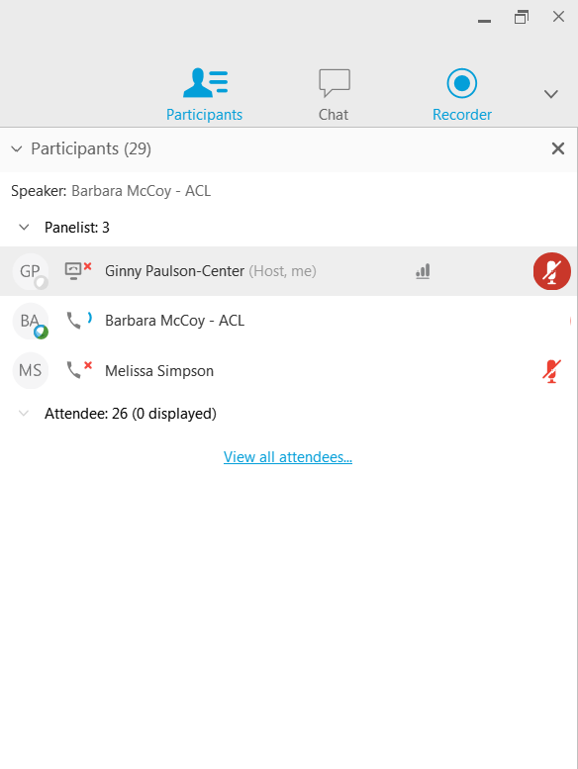

Questions: Use Chat or Raise Hand
Find the “Participants” panel on the right.
Click the hand button to raise your hand. A hand will appear next to your name.
  Tip: To lower your hand, click the hand button again.

Slide 18
Individualized Technical Assistance
To learn about future STARS training, contact your SHIP program’s leaders.
For STARS technical assistance, such as with usernames and passwords, contact the STARS help desk at Booz Allen Hamilton:
  boozallenstarshelpdesk@bah.com or 703-377-4424
For questions about job aids and other STARS support resources, contact the SHIP TA Center,
  stars@shiptacenter.org or 877-839-2675.

Slide 19

Thank you for participating!
Today’s webinar materials are available for download within WebEx.
They are also posted at https://stars.entellitrak.com
(The recording will be available within 24 hours.)
The production of this webinar was supported by grant number 90SATC0001 from the Administration for Community Living (ACL).

