Slide 1
STARS Beneficiary Contact Form Introduction
5.3.18

Slide 2
Agenda
STARS Introduction
Sharing Data
Beneficiary Contact Form Overview
Beneficiary Additional Contacts
Part D/MAPD Enrollment Data
Data Transfer from NPR
Questions

Slide 3
Stars introduction and access

Slide 4

STARS
SHIP Tracking And Reporting System (STARS)
National, web-based data system
Developed and owned by ACL OHIC
Sharing Data
  MIPPA
  SMP SIRS

Slide 5
Gaining Access to STARS
New Credentials (username and password)
  Provided by state or local program managers before ‘go live’ date
  Two auto-generated emails from Booz Allen Hamilton (BAH) DoNotReplyACLSystems@bah.com
    Username, and
    Password
Role based system
  Access will be determined by role, and
  Location in system hierarchy
Notes:
STARS Team Member:
STARS allows unlimited number of team members but
Only 450 concurrent users (those logged in at the same time)
STARS Submitter Role:
Anyone using this role will NOT count against our concurrent user number

Slide 6
View and Edit Form Permissions
Role Name | Creator Forms |  | Assignee Forms |  | Other’s Forms
 | View By | Edit | View By | Edit | View By | Edit
STARS Submitter | TI | Yes | TI | Yes | NA | NA
STARS Team Member | TI/Search | Yes | TI/Search | Yes | Search | NA
Creator = User entering form
Assignee = User listed in Session Conducted By
Other’s = User at same or lower hierarchy level
TI = use Tracking Inbox to locate forms
Search = use Search function to locate forms

Slide 7
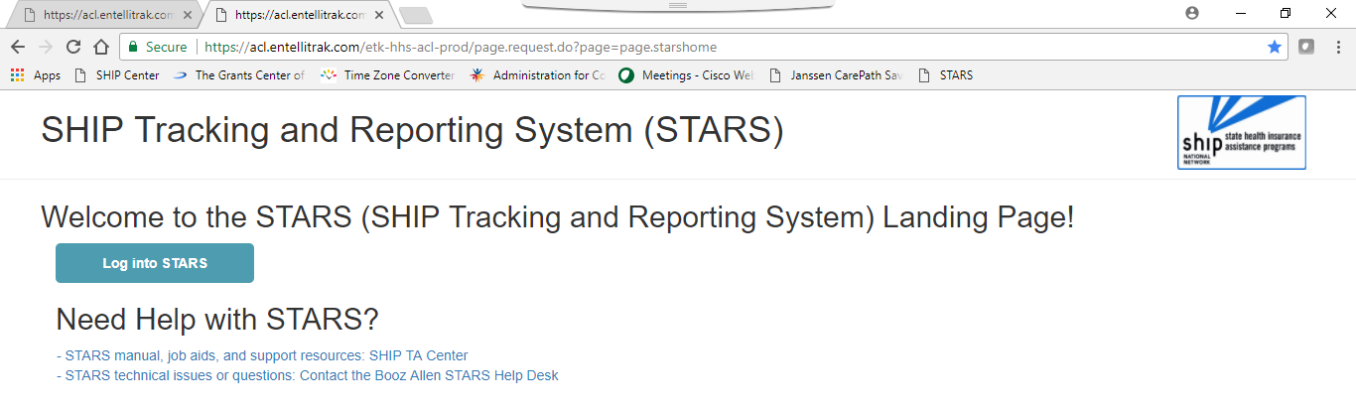
Logging into STARS
https://stars.entellitrak.com
NOTE: Username and Password are case sensitive
Notes:
Good idea to bookmark this page or save it as a favorite

Slide 8
Sharing Data
With MIPPA & SMP

Slide 9
Sharing Data Overview
Each of the three main forms (Beneficiary Contact, Group Outreach, and Media) have the ability to share data with MIPPA and/or SMP
Ensure the appropriate boxes are checked and entered in order to accurately report shared program activities

Slide 10
Beneficiary Contact Form
Notes:
What constitutes a beneficiary contact and when to complete a form has not changed from NPR. This training will focus only on the functions of STARS and the changes from NPR.
Reminder: A beneficiary contact includes all contacts for the purpose of relaying Medicare and SHIP-related information between a counselor or staff and a client. Contacts may occur with Medicare beneficiaries, family members, caregivers, or others working on behalf of a client.
A beneficiary contact does not include:
unsuccessful attempts to reach a client (e.g., leaving messages on an answering machine).
individuals reached at public events such as presentations or health fairs, or for questions asked during or after a presentation.
calls or other contact when the only purpose is to schedule an appointment with a SHIP counselor.
calls or other contact when the sole purpose is referral to another agency or program.

Slide 11
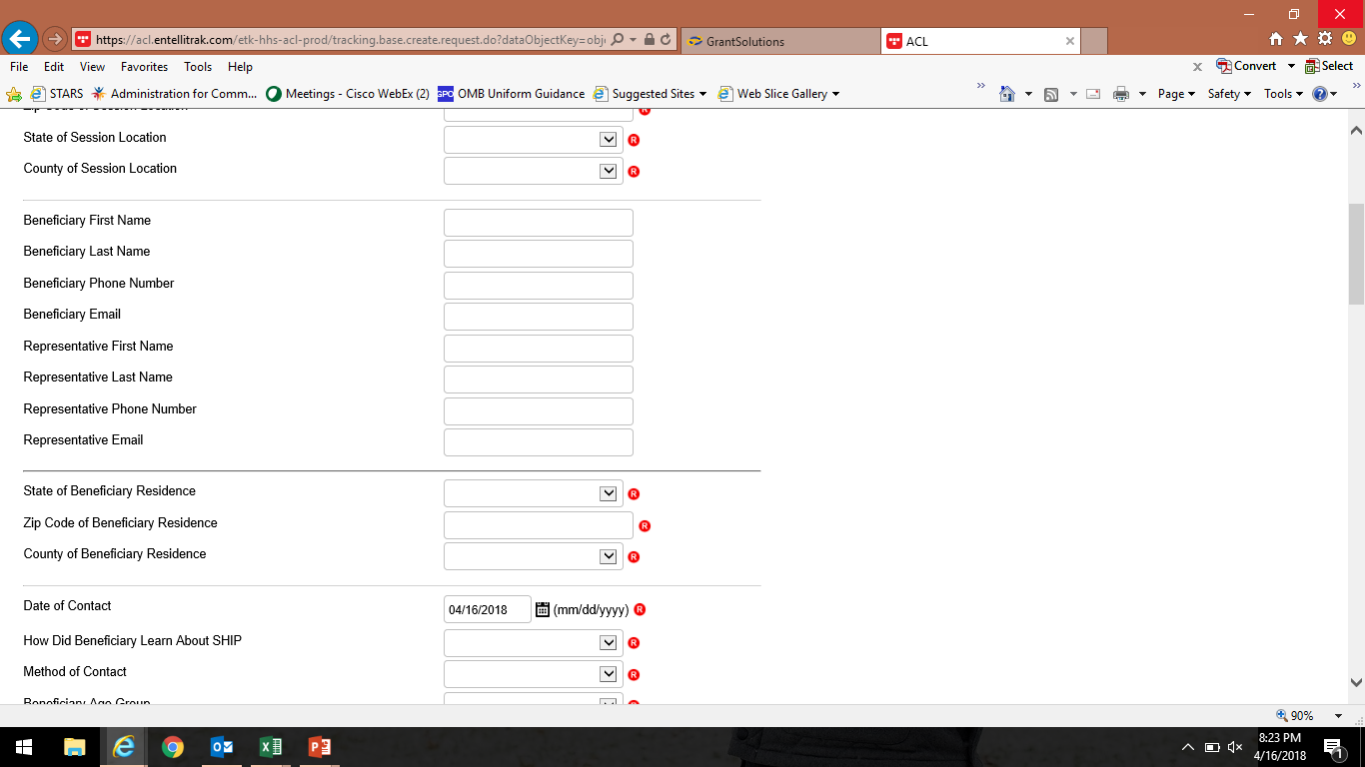
Required Fields
All Required Fields are designated with a red R located on the right hand side of the form next to the element
System note at the top of the page lists incomplete fields to complete before saving

Slide 12
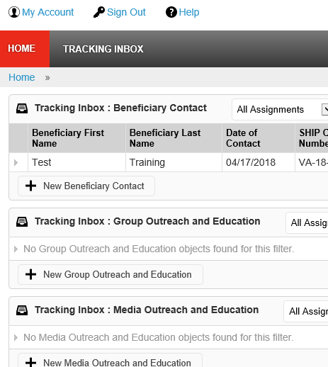
Adding a New Form
Two ways to add a new form:
  From your Tracking Inbox, or
  From the Home page
Notes:
Note: The Home page list will get really long after some time as the forms you enter populate this area which may make the “Tracking Inbox” the easiest way to start a new form.

Slide 13
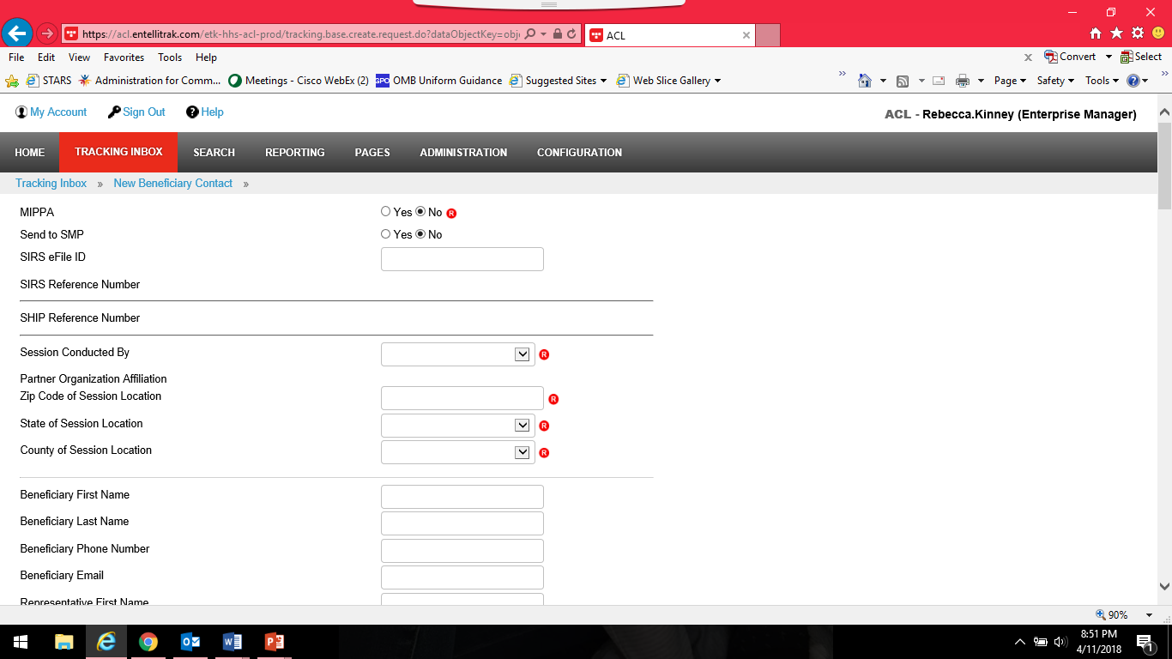
MIPPA
MIPPA Field is required
Simply check the radio button for “Yes” at the top of the page
Notes:
Medicare Improvements for Patients and Providers Act (MIPPA)
Funding for LIS/Extra Help, Medicare Savings Program, and Preventive Services outreach and enrollment assistance
Dollars to SHIP, AAA and ADRC. Usually SHIP does this work but not in all states or territories.

Slide 14
SMP Reporting
To send a form to SMP SIRS you will need to select “Send to SMP” at the top of the form
The SIRS eFile ID will be auto-populated with your SIRS eFile ID
  You can update the SIRS eFile ID to someone else’s number if you are entering the data for that person but
  The SIRS eFile ID must be present on the STARS form for the data to transfer to SIRS
Once saved the SIRS Reference Number will populate

Slide 15
SMP Reporting, cont.
Data is shared one way only (STARS to SIRS) and only once
  Cases updated in SIRS will not also be updated in STARS
  In the event of an error, you must log in and update forms in both systems to make corrections/edits
SMP Complex Interactions must be finalized in SIRS
“Send to SMP SIRS” should only be used for cases and activities that fall under both SHIP and SMP
  Only forms that include SMP related topics will be sent to SIRS

Slide 16
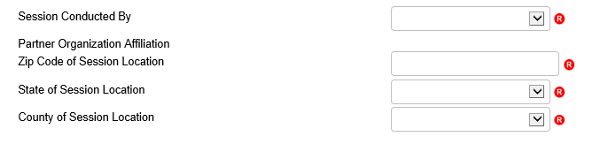
Session Conducted By
This section of the form collects information on the person that counseled or worked with the beneficiary
Use the drop down bars to select the correct options
  Partner Organization will auto-populate
  County will also auto-populate after you enter the Zip Code
  Remember: Session location is where you are when counseling; not the beneficiary’s residence

Slide 17
Beneficiary Information
Space to collect both the Beneficiary’s information and/or a Representative’s information as needed
None of these fields are required BUT please enter the name and phone number as often as possible
  ACL needs the name and phone number to conduct our beneficiary satisfaction surveys

Slide 18
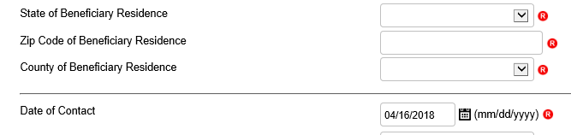
Beneficiary Residence Info
This information is required
Date of Contact
This information is required
You can manually enter the date or
Use the Date Picker tool by clicking on the calendar icon
Notes:
Must use dropdown to select state
must enter zip code
Auto-populates county based on zip code, can choose another county if applies

Slide 19
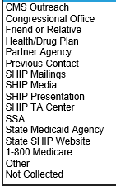
How Did Beneficiary Learn About SHIP?
Updated options include:
  Congressional Office
  Health/Drug Plan
  SHIP TA Center
  SSA
  State Medicaid Agency
Pulled “1-800-Medicare” out of the “CMS Outreach” option so now they appear as separate selections independent of each other.
Added “SHIP” as a qualifier in front of some of the selections to clarify that the selections are specific to SHIP activities/efforts. (i.e. “SHIP Mailings” and “SHIP Presentation”)
Notes:
INCREASINGLY, REALLY IMPORTANT
State or federal congressional office
Health/drug plan – your relationships, required by CMS in notices
SHIP TA – locator tracking
Based on your partnership work = SSA = based on your work at partnership, used to be included on “partner agency”
Medicaid =

Slide 20
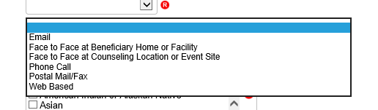
Method of Contact Changes
The options under Method of Contact have changed slightly from NPR to include Web-based contacts
  This option would be selected when using things such as website chat options to counsel a beneficiary
Notes:
Web based = working to define

Slide 21
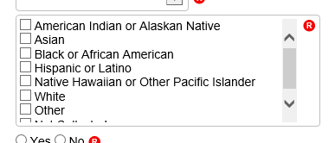
Beneficiary Demographics
Age Group - Options have not changed from NPR
Gender - Now includes “Other”
Race - Consolidated choices to mirror other ACL system fields:

Slide 22
English as a Primary Language
Select “No” when you know or can reasonably conclude that the beneficiary is not fluent in understanding, speaking, reading, and/or writing the English language.

Slide 23
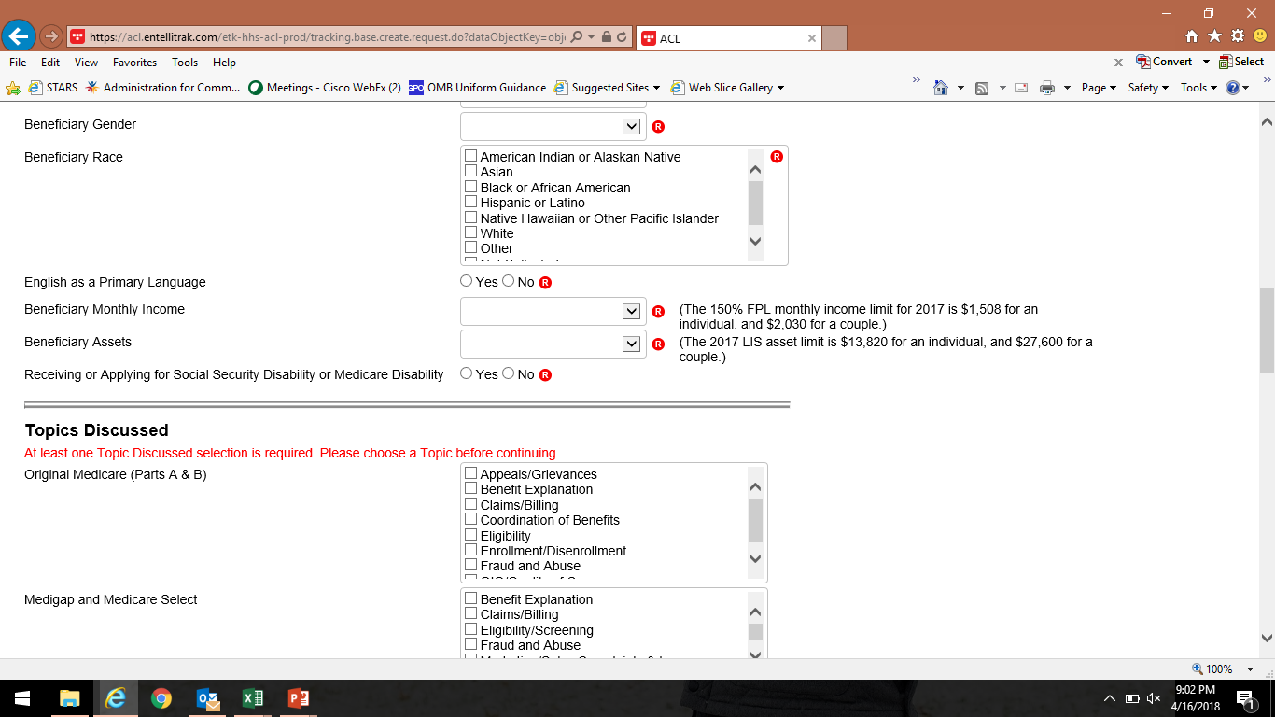
Beneficiary Income & Assets
Report beneficiary income and assets are above or below the maximum Extra Help/LIS eligibility levels (150% FPL)
“Not collected” is an option

Slide 24
Receiving or Applying for SSDI?
Select “Yes” to this question if:
  Beneficiary is under age 65 and
  Receiving or applying for Medicare and Social Security benefits due to disability or;
  Receiving Medicare because of End-Stage Renal Disease
Notes:
Just link NPR, can’t select “YES” if over age of 65

Slide 25
Topics Discussed
Largest section of the Beneficiary Contact Form
Select as many options as are necessary to fully explain beneficiary assistance
Must select at least one topic discussed
The following slides highlight changes from NPR but do not capture all of the Topics Discussed in STARS

Slide 26
New Topics Discussed: Disenrollment
New option under Medicare Advantage and Medicare Part D
  To be used plan disenrollment at any time (not limited to the Open Enrollment Period)
  Allows tracking of enrollments and disenrollments separately, lesson from Part D Enrollment Pilot

Slide 27
New Topics Discussed: Part D LIS
Two new options found under Part D Low Income Subsidy (LIS/Extra Help)
  Application Submission: Selected if assist with submission of an LIS application, either paper or electronically via SSA’s website.
  LI NET/BAE: Selected if assist accessing the limited Income Newly Eligible Transition Program (LI NET) benefit for those with an LIS award but no Part D coverage. Examples include:
    providing LI NET education to pharmacy
    submitting required documents for the Best Available Evidence (BAE) process if LIS award is not reflected in CMS/SSA systems

Slide 28
New Topics Discussed: Medicaid
Expanded options under the Medicaid header to include:
  Application Submission
  Medicare Buy-In Coordination
  Medicaid Managed Care
  Recertification

Slide 29
New Topics Discussed: Other Insurance
Several additional options have been added under Other Insurance:
  Active Employer Health Benefits
  Indian Health Services
  Retiree Employer Health Benefits
  Tricare For Life Health Benefits
  Tricare Health Benefits
  VA/Veterans Health Benefits

Slide 30


New Topics Discussed: Additional Topics
A whole new category of topics has been added under the header Additional Topic Details which includes:
  Ambulance
  Dental/Vision/Hearing
  DMEPOS
  Duals Demonstration
  Home Health Care
  Hospice
  Hospital
  New Medicare Card
  Preventive Benefits
  Skilled Nursing Facility
Note to CMS Duals Demonstration Grantees:
Contact forms must include selection of “Duals Demonstration” on this area of the form (pictured below).
Notes:
Can select these AND Original Medicare in the Parts A & B box.
These topics should allow more specific detail tracking of common concerns of beneficiaries.

Slide 31
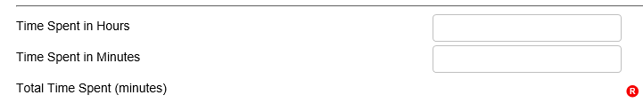
Time Spent
Enter all of the time you spent helping the beneficiary during this contact. Includes:
  All time meeting with beneficiary
  Any time spent researching, preparing materials, completing paperwork/form, and traveling to meet with the beneficiary.
Enter time in whole hours and minutes
  The system will total the time for you
Notes:
1.5 hours would be entered as either:
1 hour and 30 minutes or
90 minutes

Slide 32
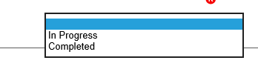
Status
STARS has only two status options:
  In progress
  Completed

Slide 33
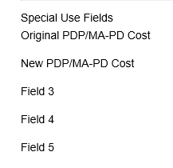
Special Use Fields
STARS has 5 Special Use Fields
Two fields are being used and are explained later
Notes:
No longer using SUF for MIPPA – recall MIPPA radial button from earlier slide

Slide 34
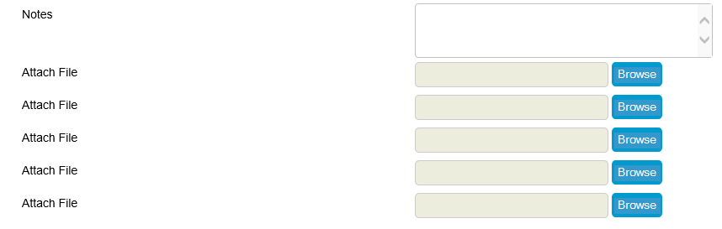
Notes and File Attachments
STARS allows you to both type in notes on the contact (similar to NPR) and
Attach supporting documents (such as PDFs or Word documents)
Notes:
Number of attachments is currently capped at 5.

Slide 35
SHIP Additional Beneficiary Sessions
Illustrating Complexity

Slide 36
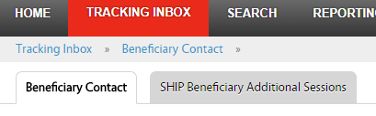
Additional Contacts on Same Issue
STARS allows users to group together multiple contacts involving the same issue
Click the SHIP Additional Sessions tab to add additional time and details
Would be used only on complex issues that require multiple contacts to complete

Slide 37
Entering Additional Contacts
Provides space to enter the additional time spent and topics discussed
Can add as many additional contact forms as needed
Each additional contact counts the same way as a stand-alone contact on SHIP Performance Measures

Slide 38
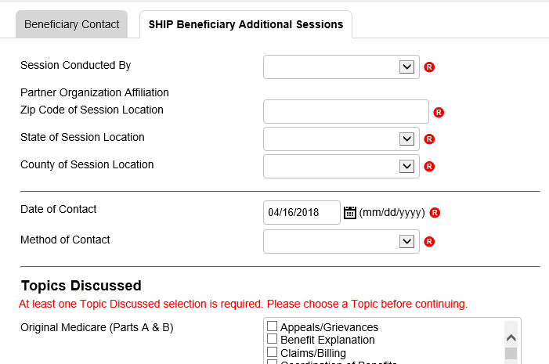
Additional Contact Screenshot

Slide 39
Part D/MAPD Enrollment Data

Slide 40
Overview
SHIP Evaluation results showed that SHIPs strongly desire a way to measure savings to Medicare beneficiaries
ACL Pilot:
  Over the last year ACL has conducted a pilot project with a number of SHIPs to test collection of enrollment data.
  Counselors in the pilot reported the before and after costs whenever they assisted with a Part D or MAPD enrollment.
  Data used comes directly from the Medicare Plan Finder
  Data from pilot was encouraging enough for ACL to decide to roll-out these data elements to everyone now
Goal is to provide more detailed information on the work that SHIPs do and the service we provide to beneficiaries

Slide 41
Components of New Data
New Data collection elements allow analysis of three components that will help measure the impact of SHIP programs’ ability to provide savings for beneficiaries:
  Number of beneficiaries who received PDP/MA-PD enrollment assistance;
  Average savings per beneficiary who received PDP/MA-PD enrollment assistance;
  Total savings for state.
Notes:
NOT a performance measure
IS a true outcome measure to share with stakeholders

Slide 42
Collection of Enrollment Data
Report Part D cost data when assisting with an enrollment in either Part D or MAPD plan
  Includes reporting cost data for both current plan and future plan (using Medicare Plan Finder info)
Cost changes must be auditable
  ACL is asking for supporting documentation to be included whenever this data new is reported

Slide 43
Part D/MAPD Enrollment Data Steps
Collect plan estimated cost information from Medicare Plan Finder (MPF)
Assist beneficiary with enrollment via MPF or via phone or paper application
  Enrollment confirmation information must be saved no matter which method of enrollment used.
Enter plan cost amounts in STARS SUFs on the Beneficiary Contact Form (BCF)
Attach MPF cost and enrollment verification to the BCF
  Proprietary system users will need to keep these documents somewhere locally where they could be accessed if audited.

Slide 44
STARS Plan Cost SUF Fields
Original PDP/MA-PD Cost
  Enter the Estimated Drug Cost* of the plan the beneficiary’s current plan listed in the Medicare Drug and Health Plan Finder
  If beneficiary has no current Medicare PDP/MA-PD plan, then enter the drug costs displayed for Original Medicare
  Round to nearest whole dollar
New PDP/MA-PD Cost
  Enter the Estimated Drug Cost* of the future plan the SHIP team member assists the beneficiary current plan listed in the Medicare Drug and Health Plan Finder
  Round to nearest whole dollar
* Enrollment timing will dictate whether the ’Estimated Drug Cost’ appears as an ‘annual’ cost or ‘rest of year’ cost.

Slide 45
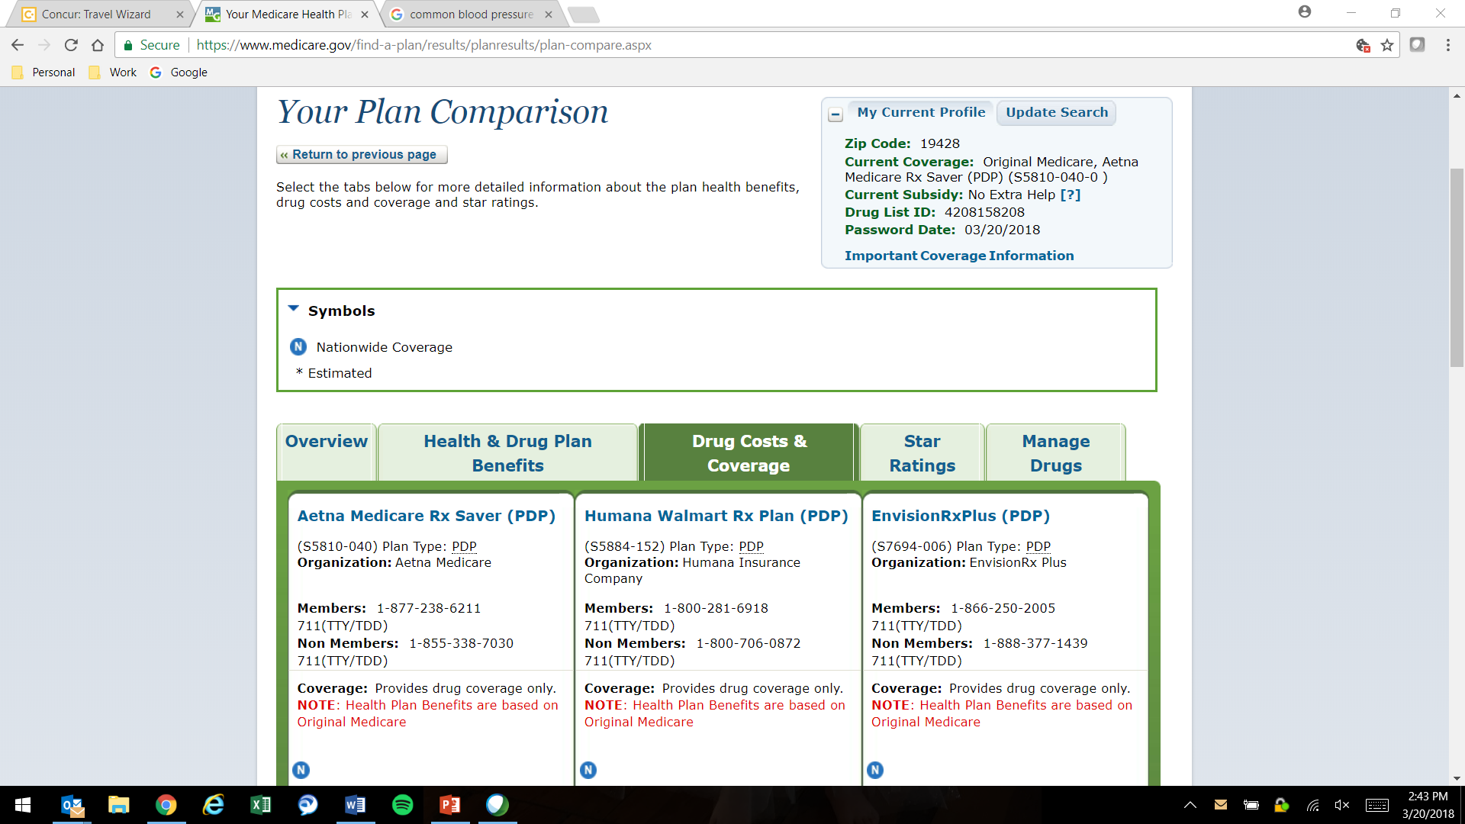
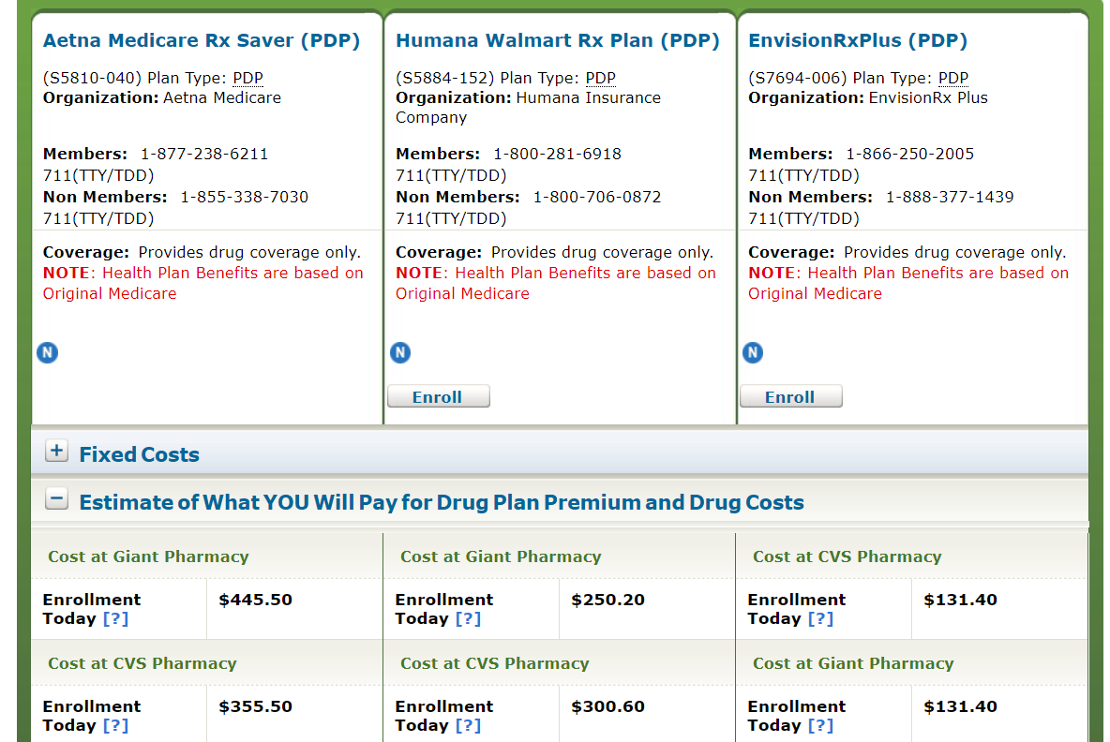
PlanFinder Cost Data
Original Part D/MAPD (current): Aetna Medicare Rx (PDP)
Cost: $446
New Part D/MAPD (future): Humana Walmart Rx Plan (PDP)
Cost: $250

Slide 46
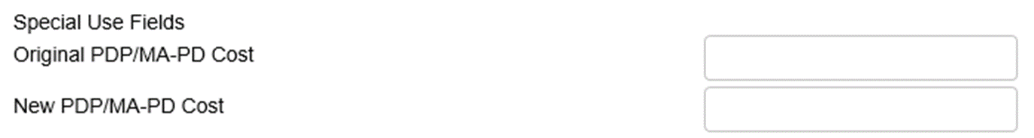

Example: Entering Cost Data in STARS
Original Part D/MAPD (current) : Aetna Medicare Rx (PDP)
Cost: $446
New Part D/MAPD (future): Humana Walmart Rx Plan (PDP)
Cost: $250
446
250

Slide 47
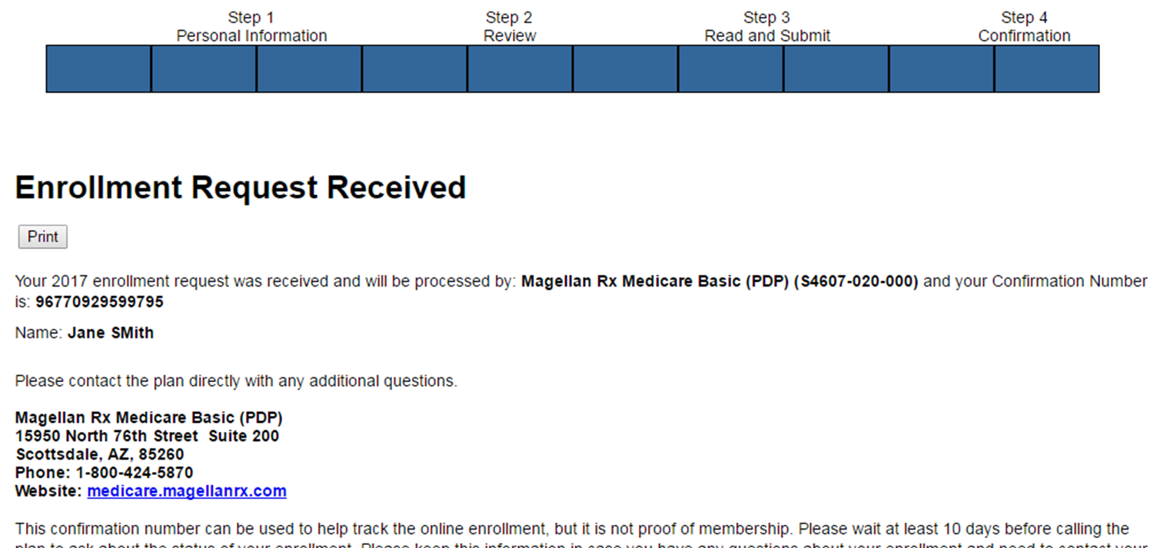
MPF Application Confirmation
New Part D/MAPD (future)

Slide 48

Attach Part D Cost Verification
Attach the following verification near the bottom of the Beneficiary Contact Form:
  1. Application confirmation (ex. previous slide)
  2. Cost change verification
    Comparison page displaying costs for the original plan and new plan (ex. slide 45), OR
    Individual plan pages for both the original plan and the new plan
Notes:
Data that is reported at the federal level is subject to significant examination by accountability entities such as Government Accountability Office (GAO) and Office of Inspector General (OIG), and therefore, ACL must ensure that the data is able to withstand the scrutiny of an audit.
There are 5 attach field fields
Verification steps;
SHIPs should conduct regular checks to verify team members enter
ACL will conduct random verification checks and remove cost change data for BCFs without these verifications.

Slide 49
Data Transfer from NPR
How is this going to work?

Slide 50
Data Transfer and Timing
BAH will transfer the data from NPR beginning in October after everyone has transitioned to STARS
Old data in NPR will be available as read-only until November 30th

Slide 51
Accessing NPR Data in STARS
NPR data will be moved to the state level in STARS
  Only State-level users will be able to see and search this data
Individual forms can be reassigned to STARS team members and sites by state level staff, BAH, or ACL if needed
Counselor field on NPR transferred data will be blank in STARS
  Counselor information will be saved in the 4th SUF in the transfer
  Agency name will be saved to the 5th SUF

Slide 52
FORM Demonstration
Questions?

Slide 53
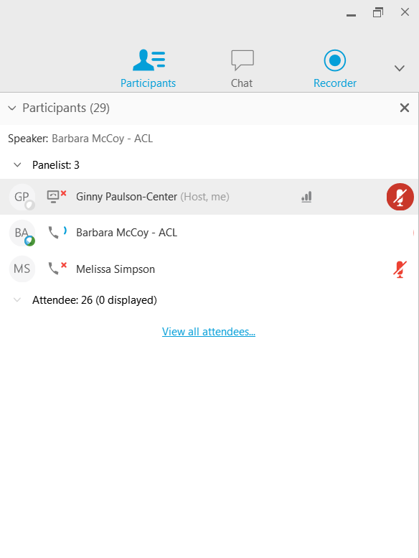

Questions: Use Chat or Raise Hand
Find the “Participants” panel on the right.
Click the hand button to raise your hand. A hand will appear next to your name.
  Tip: To lower your hand, click the hand button again.

Slide 54

Thank you for participating!
Today’s webinar materials are available for download within WebEx.
The recording will be available within 24 hours.

