Slide 1
STARS Group and Media Outreach Forms
5.9.18

Slide 2
Agenda
STARS Introduction and Access
Outreach Forms
  Group
  Media
Data Transfer from NPR
STARS Demonstration
Questions
  Chat feature

Slide 3
Stars introduction and access

Slide 4

STARS
SHIP Tracking And Reporting System (STARS)
National, web-based data system
Developed and owned by ACL OHIC
Sharing Data
  MIPPA
  SMP SIRS

Slide 5
Gaining Access to STARS
New Credentials (username and password)
  Provided by state or local program managers before ‘go live’ date
  Two auto-generated emails from Booz Allen Hamilton (BAH) DoNotReplyACLSystems@bah.com
    Username, and
    Password
Role based system
  Access will be determined by role, and
  Location in system hierarchy
Notes:
STARS Team Member:
STARS allows unlimited number of team members but
Only 450 concurrent users (those logged in at the same time)
STARS Submitter Role:
Anyone using this role will NOT count against our concurrent user number

Slide 6
View and Edit Form Permissions
Role Name | Creator Forms |  | Assignee Forms |  | Other’s Forms
 | View By | Edit | View By | Edit | View By | Edit
STARS Submitter | TI | Yes | TI | Yes | NA | NA
Team Member | TI/Search | Yes | TI/Search | Yes | Search | NA
Creator = User entering form
Assignee = User listed in Session Conducted By
Other’s = User at same or lower hierarchy level
TI = use Tracking Inbox to locate forms
Search = use Search function to locate forms

Slide 7
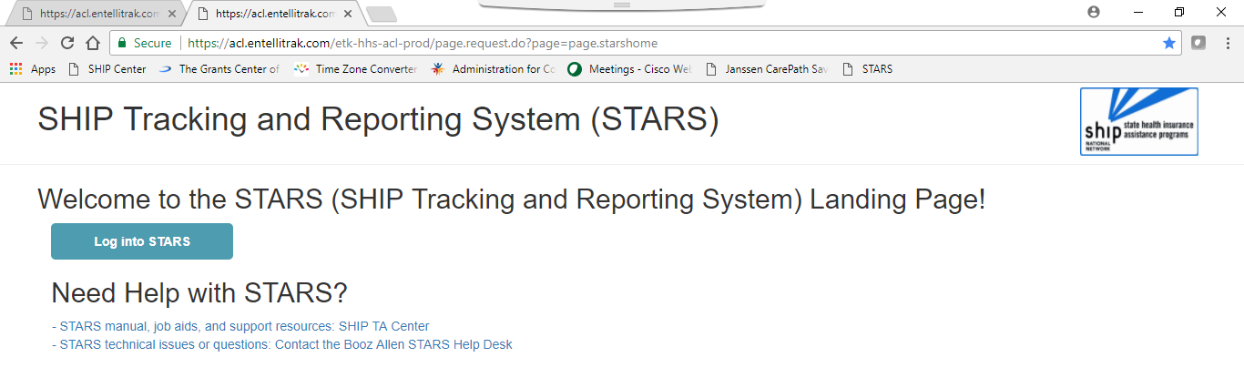
Logging into STARS
https://stars.entellitrak.com
NOTE: Username and Password are case sensitive
Notes:
Good idea to bookmark this page or save it as a favorite

Slide 8
Outreach Forms

Slide 9
Splitting the PAM Form
Split SHIP NPR Public And Media (PAM) form into two forms in STARS:
    Group Outreach
    Media Outreach and Education
Simplify which elements count towards current performance measures = Group Outreach
Remainder of form mostly unchanged

Slide 10
Group Outreach & Education (GOE)
Report
  Interactive presentations
  Booth/Exhibits
  Enrollment Events
GOE data count towards SHIP Performance Measure #2 – Number of Attendees
Select date range for multiday events
NOTE: First three options on NPR PAM form

Slide 11
Media Outreach & Education (MOE)
Remaining four options on NPR PAM (first three on GOE)
Report all other media outreach and education
Wide range of Geographic Coverage selections
Select date range for multiday events and campaigns
Billboards Email Blasts | Print Ads/Articles | Radio Television Other
Zip Code County/Counties | Statewide Multi-state | Regional National
Notes:
Wide range of Geographic Coverage selections @ SHIPs request
Help track sitting at the state fair, statewide newpaper ads, regional tv psas, etc

Slide 12
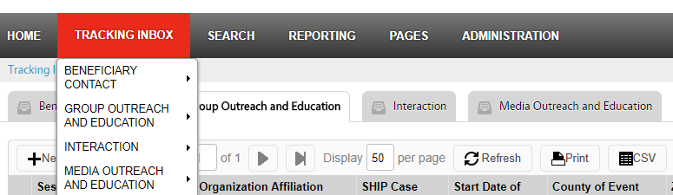
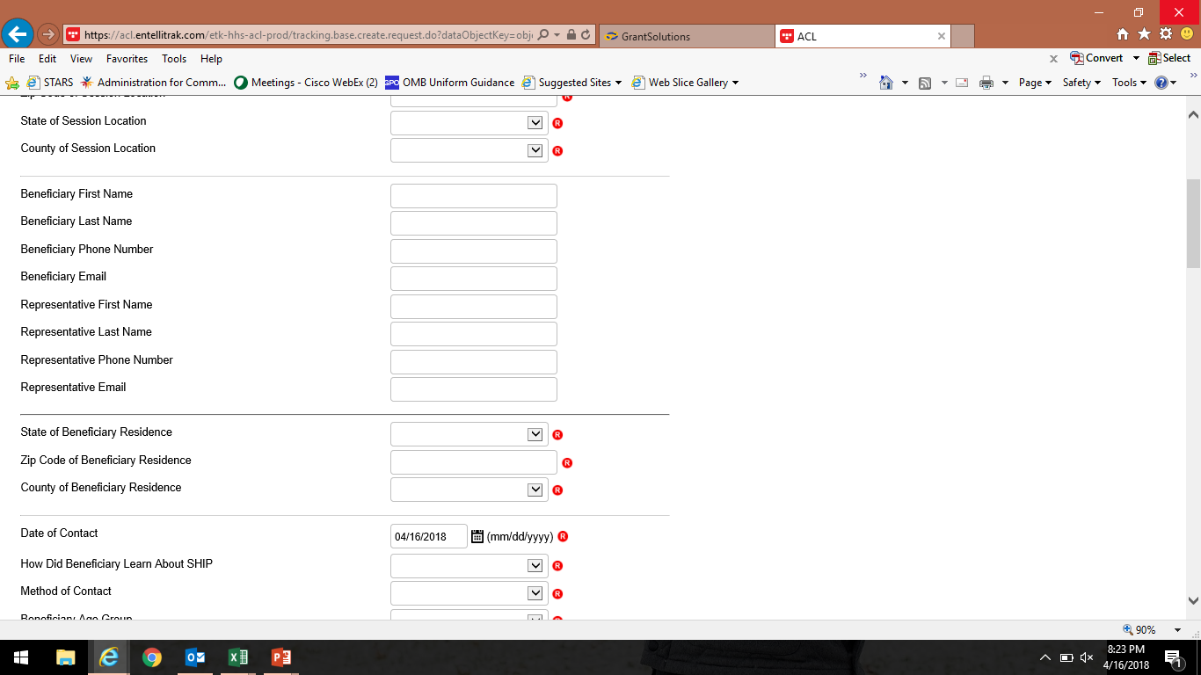
Create a Form and Required Fields
Add a new form from Home page or Tracking Inbox
Required Fields are designated with an
  Business required note appears at the top of the page if required fields are incomplete
  Note will identify the missing field and must complete to save form

Slide 13
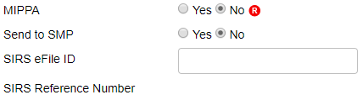

MIPPA Reporting
MIPPA is a required field
Select “Yes” radio button when outreach includes MIPPA topics
      MIPPA Topics Discussed include Extra Help/LIS, Medicaid, Medicare Savings Program, or Preventive Services
Notes:
Both Forms
MIPPA is a required field
– might recall typing in MIPPA 1, 2, or 3 in SHIP NPR
Produced inconsistent results
First question on form ☺
Select “Yes” radio button when outreach includes MIPPA topics

Slide 14
“Send to SMP” Reporting
SMP fields are not required
SIRS eFile ID will auto-populate based on
  1. Team member log in (change ID if entering another’s form)
  2. SIRS eFile ID must be present on the STARS form for the data to transfer to SIRS
SIRS Reference Number auto-populates after form is saved
Auto-populates when save form and sends to SMP/SIRS.
Notes:
SMP fields are not required – meant to ease reporting burden for joint SMP/SHIP work
SIRS eFile ID will auto-populate based on
1. Team member log in (can change if entering data forms for another team member)
2. SIRS eFile ID must be present on the STARS form for the data to transfer to SIRS
SIRS Reference Number auto-populates when form is saved

Slide 15
SMP Reporting, cont.
STARS does not eliminate need for SIRS account
  Data is shared one way only (STARS to SIRS) and only once
    Cases updated in SIRS will not also be updated in STARS
    In the event of an error, user must log in and update forms in both systems to make corrections/edits
  SMP Complex Interactions must be finalized in SIRS
  “Send to SMP SIRS” should only be used for cases and activities that fall under both SHIP and SMP
    Only forms that include SMP related topics will be sent to SIRS

Slide 16
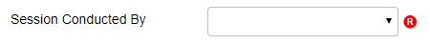
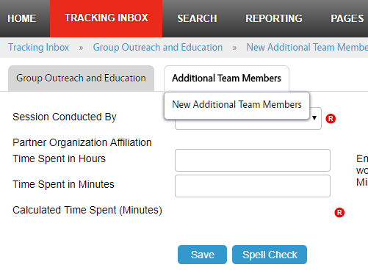
Session Conducted By and Additional Team Members
Main form allows one team member in Session Conducted By dropdown box
Click “Additional Team Member” tab after saving the main form to report team participants
Does not transfer to SIRS. Log
into SIRS to add team members.
Note: API feature does not currently support this feature. ACL is working with BAH on a possible enhancement to add this to API.
Notes:
Often need to add multiple team members time and efforts to the form, use Additional Team Member tab

Slide 17
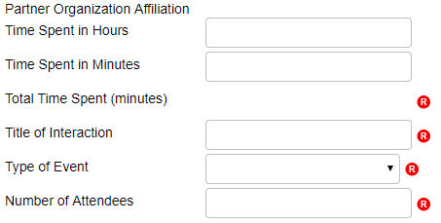

Event Details and Time
Auto-populates based on team member selection in Session Conducted By dropdown after form is saved.
Time Spent message
Notes:
Partner Org Affiliation
Will auto-populate when save the form
Time
Use either or both
See message @ bottom of screen
Title of Interaction
Event name? something helps you track
Type of event
NEW dropdown ☺
Number of attendees
just enter in this field, don’t have a list for each event type as current form
Estimating = head counts, tick marks on paper at booth, sign in sheet, etc. vs. the number of folks reported by event organizers

Slide 18
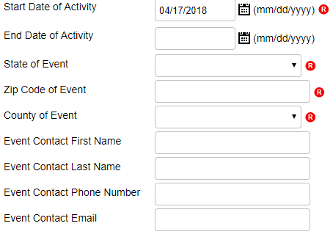
Event Details and Time Cont’d
NOTE: If entered, End Date must be a future date (e.g. 4/18/18 or later).
Notes:
NEW activity date range ☺
location
state= auto-populates based on user logged in, use dropdown to change
Zip = enter
County = auto-populates from zip code (2010 census list contact BAH help desk if zip not recognized)
Other event details optional from ACL,
state and local SHIP may require
Need for Beneficiary Survey

Slide 19
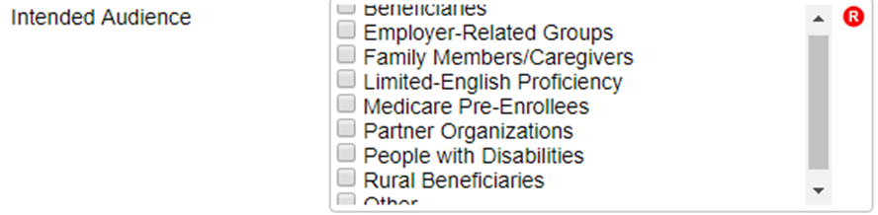
Intended Audience
Spilt Intended Audience and Target Beneficiary Group in two boxes
Required field, must select one (can multi-select)
Notes:
Previously one long list, now two shorter lists
Alphabetical order – take few times to learn this list

Slide 20
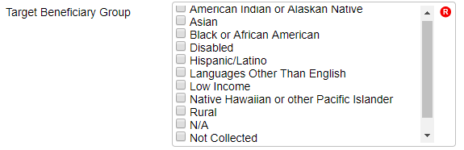
Target Beneficiary Group
Consolidated Target Beneficiary Group options to mirror other ACL system fields
Required field, must select one (can multi-select)
Notes:
Alphabetical order – take few times to learn this list

Slide 21
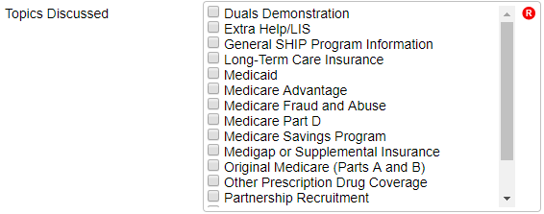
Topics Discussed
Required field, must select one (can multi-select)
Notes:
Alphabetical order – take few times to learn this list

Slide 22


CMS Duals Demo Grants
SHIPs receiving CMS Duals Demonstration Grants will continue to use STARS to track and report activities
Select Topics Discussed box “Duals Demonstration” shown below

Slide 23
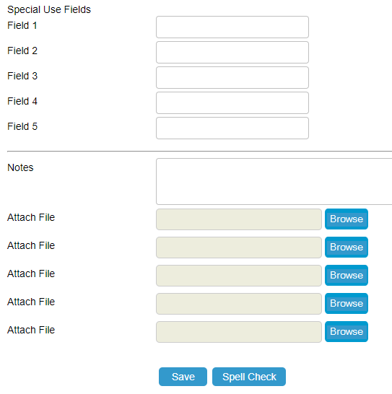
SUFs, Notes, and Attach File
Special Use Fields
  No longer use for MIPPA!!!
  4th and 5th for NPR transfer data
Notes
  Track ‘other’ by typing consistent (e.g. Non-STARS Event Partners, New Medicare Card, etc.)
Attach file
Notes:
Special Use Fields
No longer use for MIPPA!!! = use MIPPA radial button instead at top of form
4th and 5th for NPR transfer data = only being used for transferred data, available otherwise, just FYI
Notes
Track ‘other’ by typing consistent (e.g. Non-STARS Event Partners, New Medicare Card, etc.)
Attach file
Any file type
5 files

Slide 24
Data Transfer from NPR

Slide 25
Data Transfer and Timing
BAH will transfer the NPR data in October when all SHIPs are using STARS and no longer entering data into NPR
NPR data will be available as read-only until November 30th after STARS user account is active
  For example, 7/1/18 STARS ‘go live’ date
    NPR data entry ends 6/30/18
    NPR read-only access 7/1/18 to 11/30/18
    Begin data entry in STARS 7/1/18

Slide 26
Accessing NPR Data in STARS
NPR data will be moved to the state level in STARS
  Only State-level users will be able to see and search this data
  Agency Name will be saved to the 5th SUF
    Recommend search by Agency name to find NPR data in STARS
  Presenter(s) name will be saved in 4th SUF
Individual forms can be reassigned to STARS team members and sites by state level staff, BAH, or ACL if needed

Slide 27
Form Demonstration
Questions?

