Slide 1
STARS Reports
Presented by: the Administration for Community Living (ACL)
and the SHIP National Technical Assistance Center (SHIP TA Center)
June 2020
Notes:
Welcome to today’s webinar. Today’s speakers are Maggie Flowers from ACL and Ginny Paulson from the SHIP TA Center. This webinar will provide an overview of all types of reports in STARS, with a special emphasis on the SHIP Performance Measures reporting. We will also explain the new reports that have been added in 2020, called Data Export Reports and Summary Reports.

Slide 2
Agenda
SHIP Performance Measures
STARS Reports
  Overview
  Each Type
Questions?

Slide 3
SHIP Performance Measures
Maggie Flowers, ACL
Notes:
ACL

Slide 4
ACL Overview
Report Due Dates
  Follow the STARS data entry deadlines, and you will automatically be reporting “on time”
  ACL generates reports “as-needed”
Medicare-eligible population data in STARS (denominator data)
  System currently houses original data from STARS launch
  2018, 2019, 2020 denominator coming soon
What are Likert Ratings and Targets?
  Targets are based on past Likert ratings with Targets being aspirational goals for the next year
COVID-19 Impact
Notes:
PMs stands for Performance Measures. SHIPs will receive a Likert rating for each PM based on past year’s performance.

Slide 5
Likert Ratings for Each PM
Score Location | Rating
Top 10% (5 States) | Excellent
Next 20% (11 States) | Good
Middle 40% (22 States) | Average
Next 20% (11 States) | Fair
Bottom 10% (5 States) | Low
Notes:
SHIPs will receive a Likert rating for each PM based on past year’s performance. SHIPs receive an aspirational target rating for the new year.

Slide 6
Due Dates for Data Entry
Month Effort Occurred | Data Entry Due Dates for Efforts
January | February 28
February | March 31
March | April 30
April | May 31
May | June 30
June | July 31
July | August 31
August | September 30
September | October 31
October | November 30
November | December 31
December | January 31
Important for accurate reports
However, if you miss these deadlines, you can still enter your data
  “Better late than never”
Notes:
See Chapter 1 of the STARS manual

Slide 7
Medicare-Eligible Population Data in STARS
Denominator Data
PM 1 | CMS October Medicare enrollment file
PM 2 | CMS October Medicare enrollment file
PM 3 | CMS Chronic Condition Data Warehouse
PM 4 | Low-income: LIS beneficiary population (CMS data) Rural: CMS October Medicare enrollment file filtered by Medicare beneficiaries in counties identified as rural by CDC National Center for Health Statistics (NCHS) ESL: Estimated from Census Bureau American Community Survey
PM 5 | CMS October Medicare enrollment file
Notes:
CDC = Centers for Disease Control. This data is embedded in STARS.

Slide 8
Performance Measure Report – PM1
PM1: Client Contacts
Percentage of total client contacts per Medicare beneficiaries in the state.
STARS data used – PM 1 Client Contacts:
All Beneficiary Contact Forms and SHIP Beneficiary Additional Sessions Forms that have at least one topics discussed selected
Notes:
ACL

Slide 9
Performance Measure Report – PM2
Percentage of persons reached through presentations, booths/exhibits, and enrollment events per Medicare beneficiaries in the State.
STARS data used – PM 2 Outreach Contacts:
Number of Attendees reported on the group Outreach and Education form
  Note: Estimated number of people reached in Media Outreach and Education forms does not count
PM2: Outreach Contacts
Notes:
ACL

Slide 10
Performance Measure Report – PM3
Percentage of contacts with Medicare beneficiaries under the age of 65 per Medicare beneficiaries under 65 in the State.
STARS data used – PM 3 Medicare Beneficiaries Under 65:
All Beneficiary Contact Forms with both "Receiving or applying for Social Security Disability or Medicare disability" and "64 or younger" selected. Also counted are any SHIP Beneficiary Additional Session Forms for Beneficiary Contact Forms that have both "Receiving or applying for Social Security Disability or Medicare disability" and "64 or younger" selected.
PM3: Medicare Beneficiaries Under 65

Slide 11
Performance Measure Report – PM4
Percentage of low-income, rural, and non-native English contacts per total “hard-to-reach” Medicare beneficiaries in the State.
STARS data used – PM4: Hard-to-Reach Contacts:
All Beneficiary Contact Forms with at least one hard-to-reach demographic. Also counted are any SHIP Beneficiary Additional Session Forms for Beneficiary Contact Forms that meet this criteria.
The designated "hard to reach" selections are:
  Low income: “Beneficiary Monthly Income” = Below 150% FPL
  Non-native English speaker: “English as a Primary Language” = No
  Rural: County needs to meet ACL’s classification
PM4: Hard-to-Reach Contacts
Notes:
ACL. There is a handout explaining the Rural classification that accompanies today’s webinar and is in the STARS Resources Kit on the SHIP TA Center’s website. Beneficiaries whose zip code is in a county classified in a nonmetropolitan category according to the Centers for Disease Control, National Center for Health Statistics (NCHS), Urban-Rural Classification Scheme:
• 6 levels (slices) previously used: 1) large central metro; 2) large fringe metro; 3) medium metro; 4) small
metro: 5) micropolitan; 6) noncore (aka outside)
• The last two = Rural:
o Micropolitan (MIC): population 10,000 – 49,000
o Outside (OUT): noncore

Slide 12
Performance Measure Report – PM5
STARS data used – PM5 Enrollment Contacts:
Beneficiary Contact Forms and SHIP Beneficiary Additional Sessions Forms with at least one enrollment topic selected under the Topics Discussed
PM5: Enrollment Contacts
Percentage of unduplicated enrollment contacts (i.e., contacts with one or more qualifying enrollment topics) discussed per Medicare beneficiaries in the State.
Notes:
ACL. Notice the SHIP TA Center has a handout listing these topics.

Slide 13
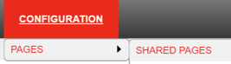
STARS Reports Overview
Ginny Paulson, SHIP TA Center
Notes:
Our focus today will be reports in the Configuration menu on Shared Pages.

Slide 14
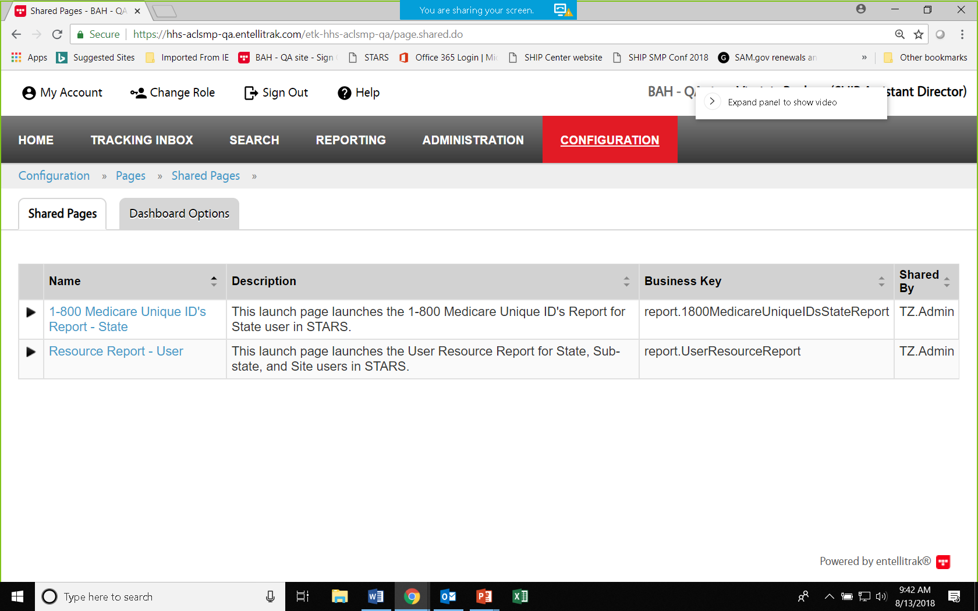
3 Ways to Find Data
Tracking Inbox: Find data entered by you and about you. Use column headings to sort in ascending or descending order.
Search Menu: Find data entered by anyone, if it is visible to your role, using search tools to filter.
  Beneficiary contact Topics Discussed are not searchable; use the Data export and Summary instead
Reports: Formatted, quantified, aggregated data.
  They are in the Configuration menu.
  Note: Information in the Reporting menu
  for directors and assistant directors has
  been replicated under Configuration
Notes:
Reports note: Later we will explore the new data export and summary reports added to the Configuration menu in February. Prior to their development, the Reporting menu provided directors and assistant directors with some custom reports to see topics discussed on the beneficiary contact forms. Now, the data export and summary reports contain that information are also available to more user roles.

Slide 15
Role-Based Configured STARS Report Access
STARS Role | Performance Measures, Resource, Data Export, and Summary Reports | Unique ID Report
SHIP Director | State level, sub-state level, or site level report | State level, sub-state level, or site level report
SHIP Assistant Director | State level, sub-state level, or site level report | State, sub-state or site level report
State Staff | State level, sub-state level, or site level report | No access
Sub-State Manager | Sub-state or site level report | No access
Site Manager | Site-level report | No access
Notes:
This chart lists the currently available configured STARS reports and the five STARS user roles that can access configured STARS reports.

Slide 16
Overview of Configured Reports
Performance Measures Reports
Resource Report
Summary Reports [New in Feb 2020!]
Measures performance according to national measures implemented by ACL
Gathers demographic and time spent metrics on team members
Total most aspects of all beneficiary contacts, but do not contain identifying info like case #s
Data Exports
[New in Feb 2020!]
Total selected aspects of beneficiary contacts and contain identifying info like case #s and date.
CMS Unique IDs
Available only to directors and assistant directors - lists team members and their Unique IDs

Slide 17
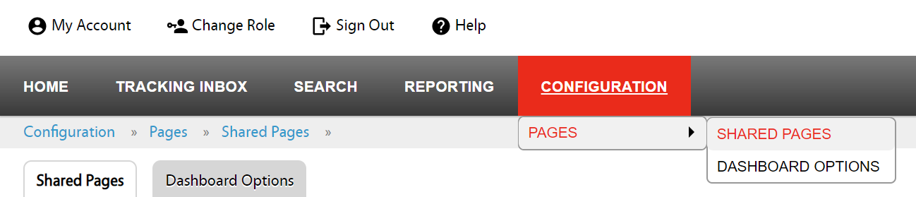
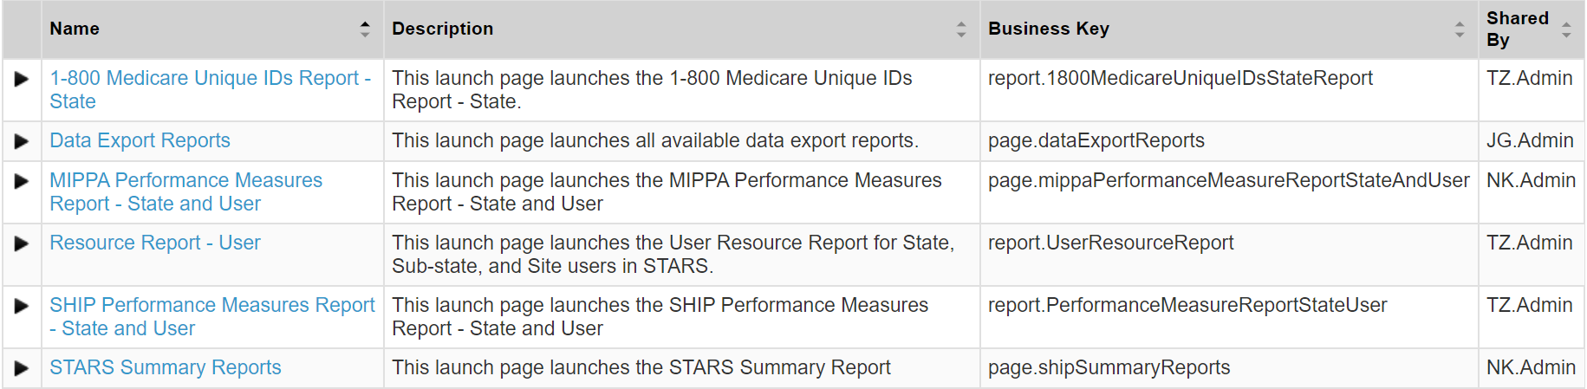
Accessing Configured Reports
Step 1
Step 3
Step 2
Notes:
After selecting the report of your choice, follow the easy on screen prompts to select your desired partner organization and date range. Most reports can be run for up to a one year time frame, but the Summary Reports can only be run for up to a 6 month time period. Resource Reports must be run for whole months. For example, run one for all of January through all of December, not for mid-January through mid-December. This is because time spent on the team member Activity form is entered in monthly aggregated amounts. They cannot be divided down to the daily level.

Slide 18
Date Range Criteria and Maximums
Performance Measures Reports
Resource Report
Data Exports
Calendar year or less (any date range within that maximum)
Up to a year, in monthly increments
One month maximum (any days within that maximum)
Summary Reports
Six month maximum (any date range within that maximum)
Notes:
The CMS Unique ID Report does not use date ranges.

Slide 19
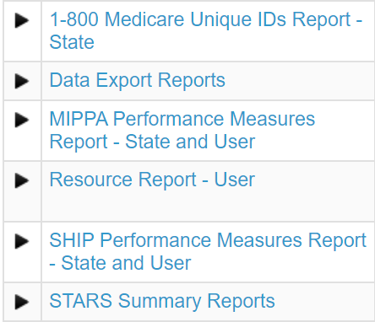
Types of Reports (in Greater Depth)
Ginny Paulson, SHIP TA Center
Notes:
Next, we will talk about the types of Reports in STARS, starting with those we’ve had the longest: Performance measures reports, the Resource Report, and the 1-800-Medicare Unique IDs Report.

Slide 20
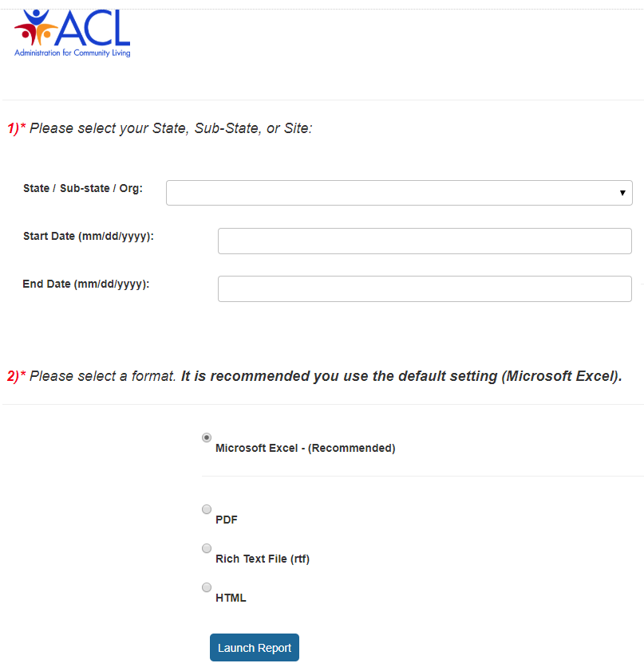
To Run a Performance Measure Report
Choose state, sub-state or site, then date range
Choose format (excel is the default)
Click Launch
Notes:
First we will address the Performance Measures Reports.

Slide 21
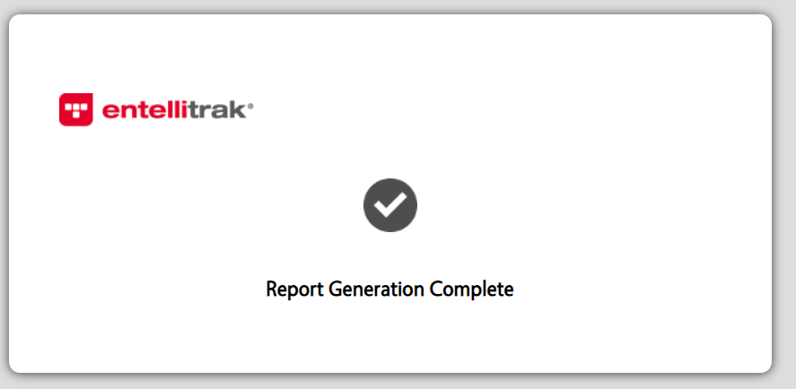

Report Generation Confirmation
After the report generation message appears, you must usually wait for the excel file to load
Notes:
Ginny

Slide 22
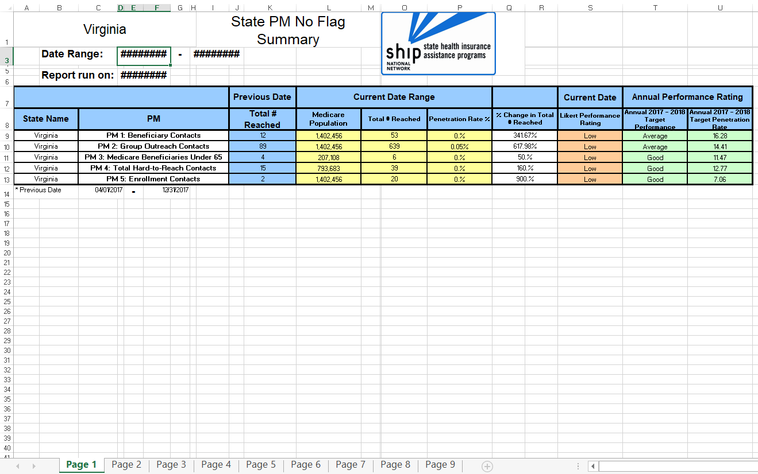
Sample SHIP Performance Measure Report:
Widen the F and J columns if needed (to see dates instead of #######)
A note below PM 5 explains the dates used for the “Previous Date” range
State-level users only: Navigate tabs 2 – 9 for additional PM-specific data
Notes:
Ginny. This is a state-level report run by a director, assistant director, or state staff user. Notice the tabs at the bottom of the screen. Currently, sub-state managers and site managers only have Page 1 – the summary. They do not have the remaining tabs. The first column is your state. The second column is the performance measure. The third column is the comparison data – “Previous Date” – which is the same date range but for the previous year. Your current Performance Measures results are in yellow, with the Performance Measure itself being the penetration rate (3rd yellow column).

Slide 23
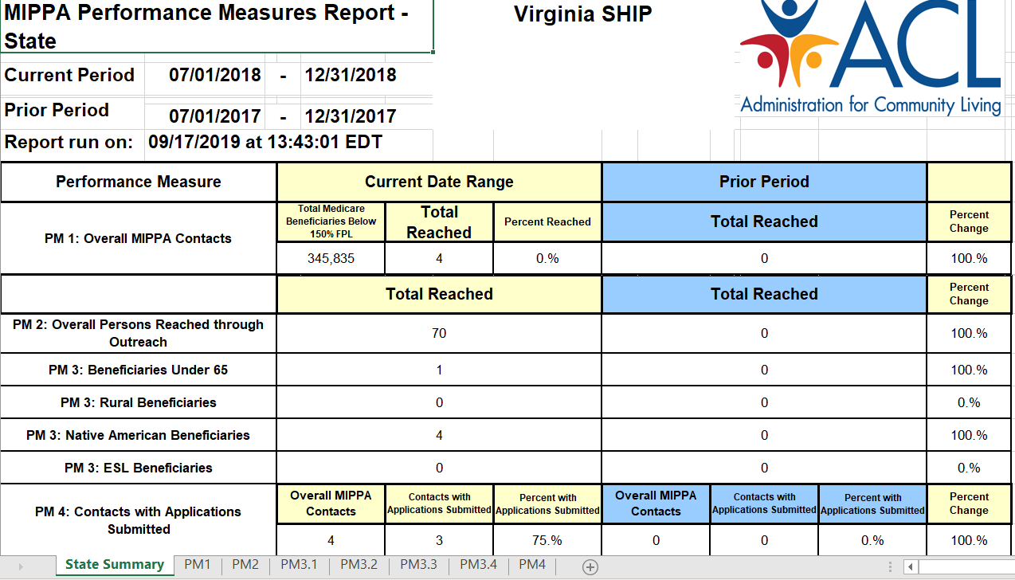
Sample MIPPA Performance Measures Report
Only directors have these tabs that break down PMs by county and rural designation
Notes:
Directors have additional details for each measure in the tabs at the bottom, including county-level outcomes. The September 2019 webinar spoke in depth about MIPPA Performance Measures, and we will conduct another webinar in July about the MIPPA Performance Measures Report that will delve into each performance measure.

Slide 24
The Resource Report
Gathers metrics on the various demographics of team members
A team member is deemed active if they have time entered during the report date range
Any category on the team member’s Activity form
Any form when named in *Session Conducted By field
Training time is currently entered in the “Other” category on Activity Forms, which appears in the “Other Activities” column, but a new STARS training form is under development
Hours spent according to role, paid status, and type of work
# of active team members by STARS role, paid status, and characteristics
Notes:
Metrics include hours by Paid Staff, vs. In-kind staff, vs. volunteers (those are the three options for Paid Status). They are divided by STARS user role and according to the type of work. The current options are Beneficiary Contacts, Group Outreach, Media Outreach, and “Other Activities.” As a reminder, Other Activities are the aggregated hours from the Activity Form, which is tied to the Team Member Form. These Other Activity hours must be manually entered into STARS. If you are a program that uses a propriety data system to send most data to STARS, don’t forget to manually enter time spend on other activities. The Resource Report also only includes your demographic characteristics for your team members who were active during the report date range. Finally, a training time is currently entered on the Activity Form in the “Other” category, but a future enhancement will change that. Training will become a separate category on the Resource Report and the time will be entered on a new Training Form under development.

Slide 25
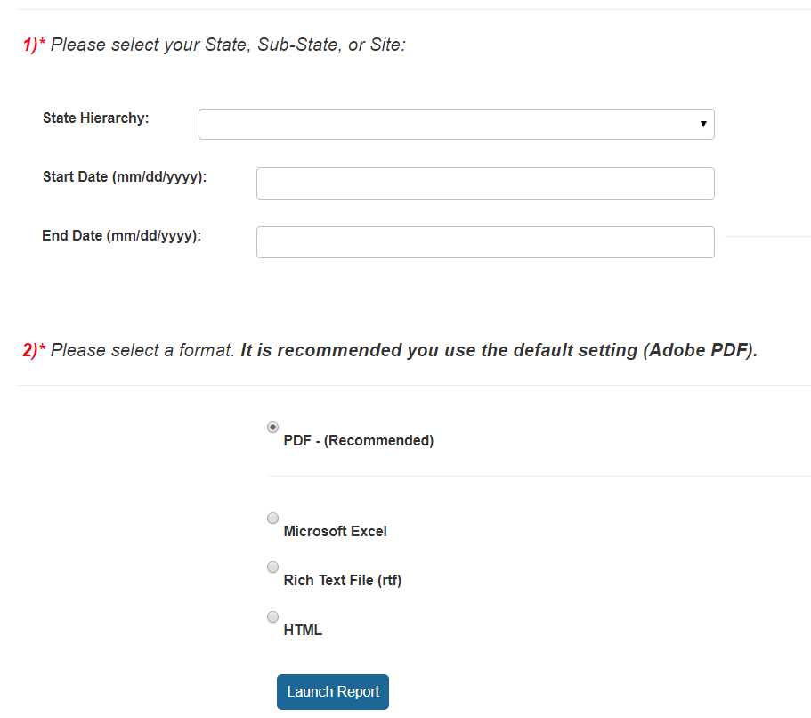
To Run a Resource Report
Click the arrow to see your hierarchy and make a selection
Enter your date range
PDF recommended but not required
Notes:
Ginny

Slide 26
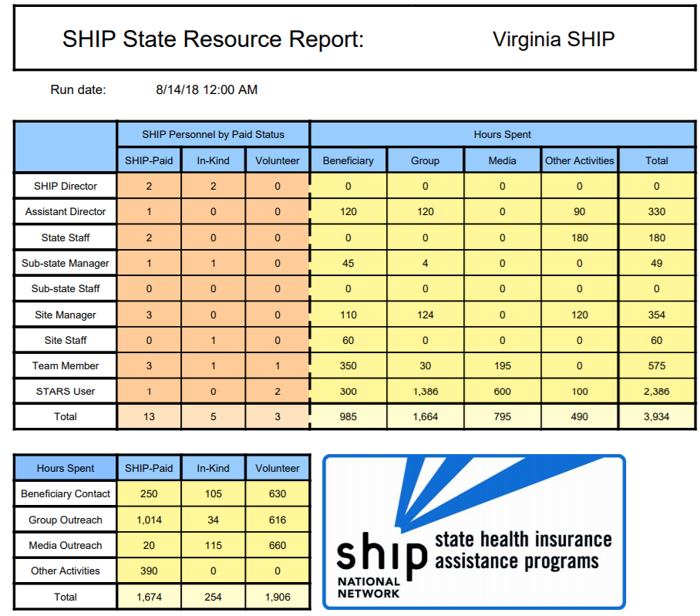
Sample
Resource Report:
Top Half of the Report
Notes:
Ginny. This is from test data in our test site.

Slide 27
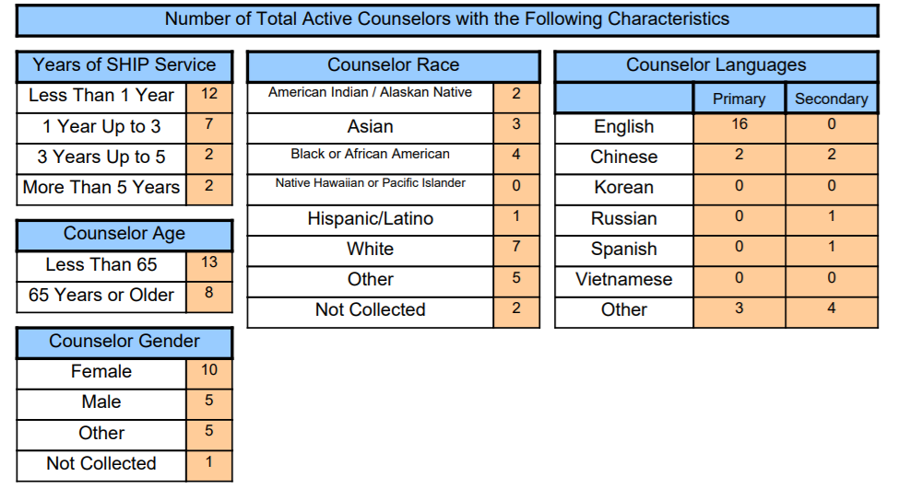
Sample Resource Report:
Bottom Half of the Report
Notes:
Ginny

Slide 28
The1-800-Medicare Unique ID Report
Also referred to as the CMS Unique ID Report
Allows ACL to provide the Centers for Medicare and Medicaid Services (CMS) a list of users who have active CMS Unique IDs in the system.
The state-level Unique ID report is for SHIP Director and SHIP Assistant Director users only and for their state/territory only
See the CMS Unique ID job aids for more information about the CMS Unique ID system
  There is one job aid for directors and another for users
Notes:
ACL. The job aids are in the SHIP Resource Library at www.shiptacenter.org. See the Featured Resource “STARS Resources Kit” for convenient access, or conduct a keyword search for “Unique ID.”

Slide 29
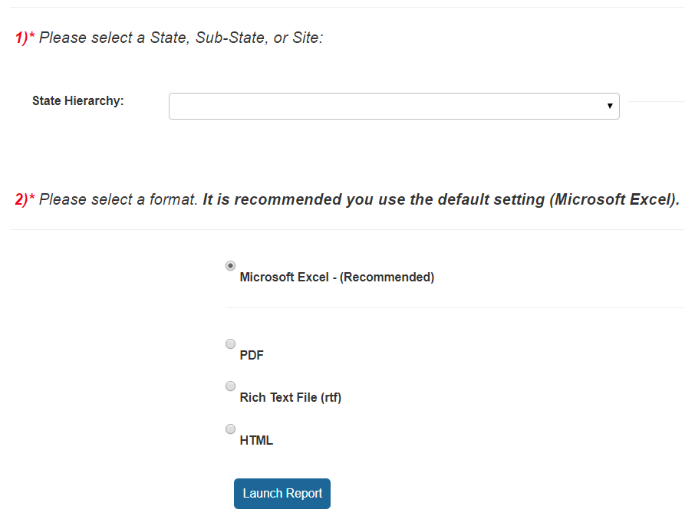
To Run this Report:
How to Run a 1-800-Medicare Unique ID Report
Click the arrow to see your hierarchy
Excel recommended
Notes:
Ginny. After selecting the report by name in your Configuration menu, follow these steps. As a reminder, the report is not yet available to you.

Slide 30
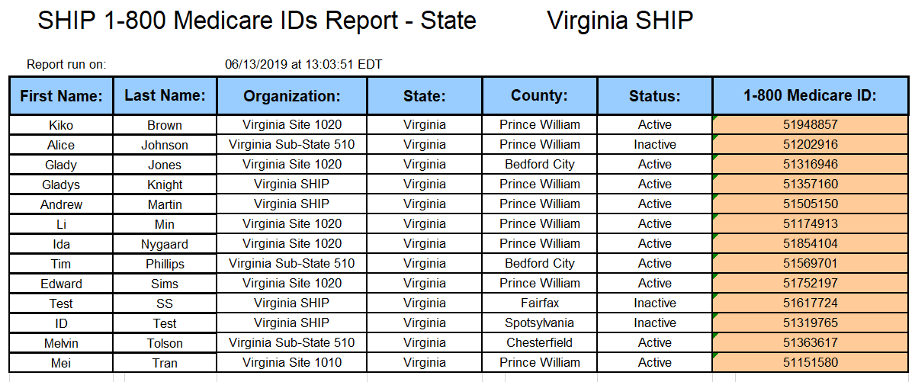
Unique ID Report Layout
The sample below is from a test site with test data.
Notes:
Ginny. Report will display Team Members who have a CMS Unique ID Status of "Inactive" and "Active.“

Slide 31
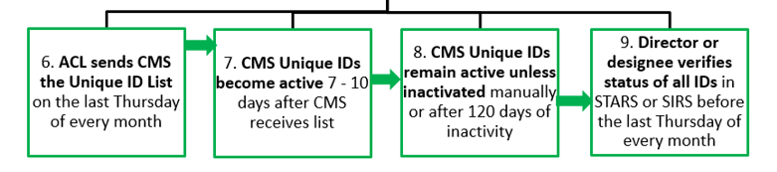
Review this report monthly
Review prior to the last Thursday of each month
Check the active/inactive column so team members retain or lose Unique ID privileges appropriately
See the Director Deadlines section of CMS Unique ID job aid for directors for details (page 7)
Overview:
Notes:
Note: SIRS is the SMP data system. SMPs have CMS Unique IDs too.

Slide 32
Summary Reports and Data Exports
(Alike and Different)
ALIKE: Currently available versions are about beneficiary contacts, run by STARS partner org. (including state-level), and replace the advanced search for beneficiary contacts topics discussed.
DIFFERENCES:
Summary Reports
Totals most fields on both BCF & BAS (all topics discussed)
No unique identifying information (such as case #)
Six-month time frame max
Two options: One SHIP and one MIPPA
Data Exports
Totals specific fields on either BCF or BAS
Includes unique identifying information (date, case #, zip)
One-month time frame max
Six options: two SHIP, two MIPPA, and two SMP
Notes:
BCF is the Beneficiary Contact Form; BAS is the Beneficiary Additional Sessions Form.

Slide 33
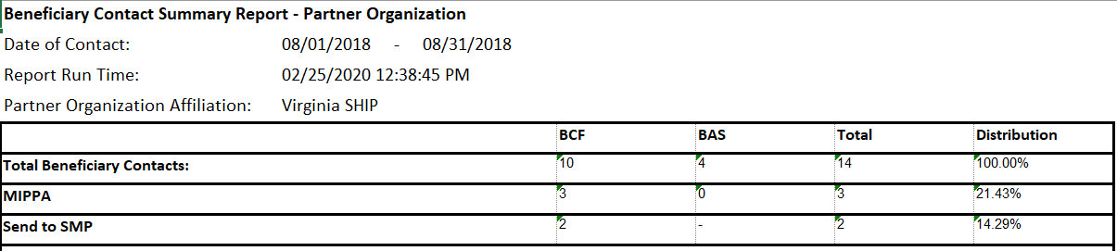
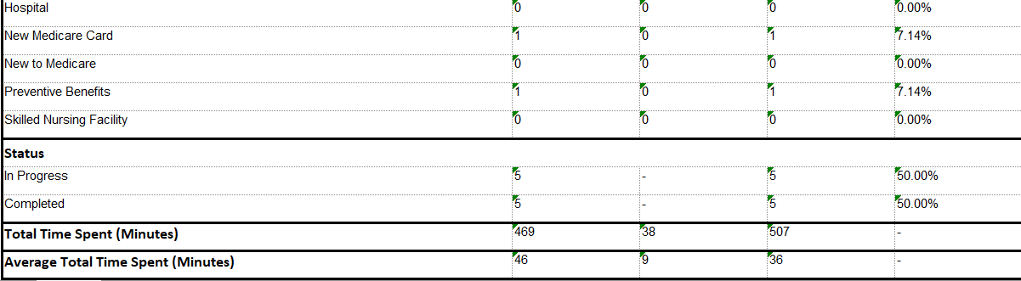
Sample STARS Summary Report
TOP of Report
…Scroll…
BOTTOM of Report
Notes:
There are two Summary Reports –Beneficiary Contact Summary Report and MIPPA Beneficiary Contact Summary Report. Both filter by Partner Organization, so you can choose your State in the hierarchy or any organization at the sub-state or site-level.

Slide 34
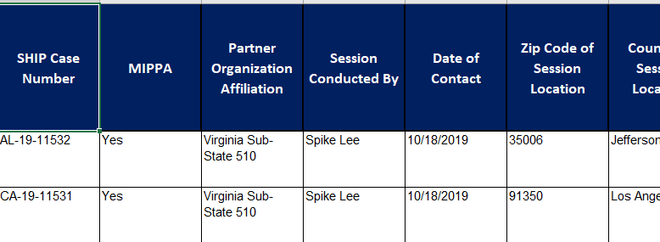
Sample Data Export Report
Excel spreadsheet. Fields depend on type of Data Export selected.
Importantly, this report will allow you to find forms in STARS to edit, if potential errors are detected.

Slide 35
Individualized Technical Assistance
For STARS technical assistance, contact the STARS help desk at Booz Allen Hamilton:
  boozallenstarshelpdesk@bah.com or 703-377-4424
For questions about STARS training and resources, contact the SHIP TA Center:
  stars@shiptacenter.org or 877-839-2675
Today’s Speakers:
  Maggie Flowers: margaret.flowers@acl.hhs.gov
  Ginny Paulson: gpaulson@shiptacenter.org

Slide 36

Questions?
The menu at the bottom middle of your screen allows you to access Webex tools, including chat. Please send your questions by chat, due to the large group size.
Tip: if you don’t see the menu, hover your mouse around the bottom of the screen to activate menu.
Mute Participants Chat Audio Leave
Notes:
Sue: After providing instructions for questions, say: Today’s webinar materials are available for download within WebEx.

Slide 37
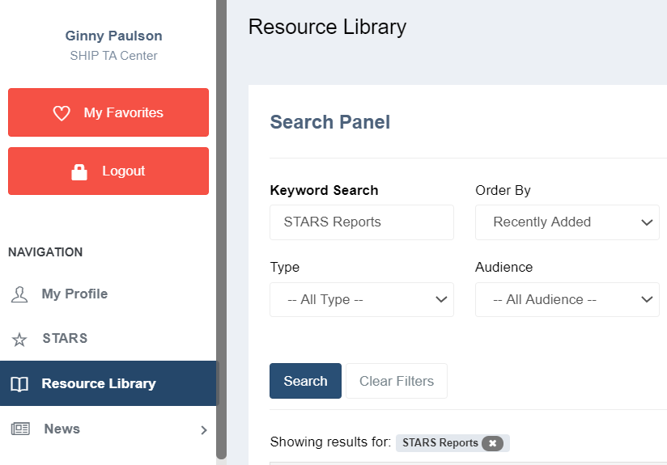
Today’s Resources
Available for file transfer in Webex
In the STARS menu, and
In the Resource Library
Recording added tomorrow

Slide 38

Thank you for participating!
Today’s webinar materials are available for download within WebEx.
This webinar was supported, in part, by grant number 90SATC0001 from the U.S. Administration for Community Living, Department of Health and Human Services, Washington, D.C. 20201.

Slide 39
Appendix A: Accessing STARS Resources
Webinars
Manual
Job Aids
Notes:
Ginny

Slide 40
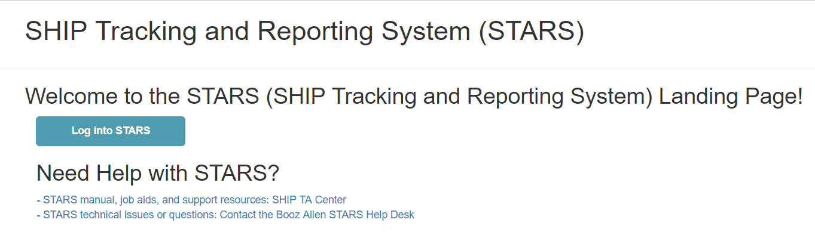
STARS Landing Page
https://stars.acl.gov
Contains link to SHIP TA Center’s STARS Resources page
Contains link to Booz Allen STARS Help Desk
Notes:
Anyone with the link can visit the STARS landing page. BUT, only users with credentials can successfully log in.

Slide 41
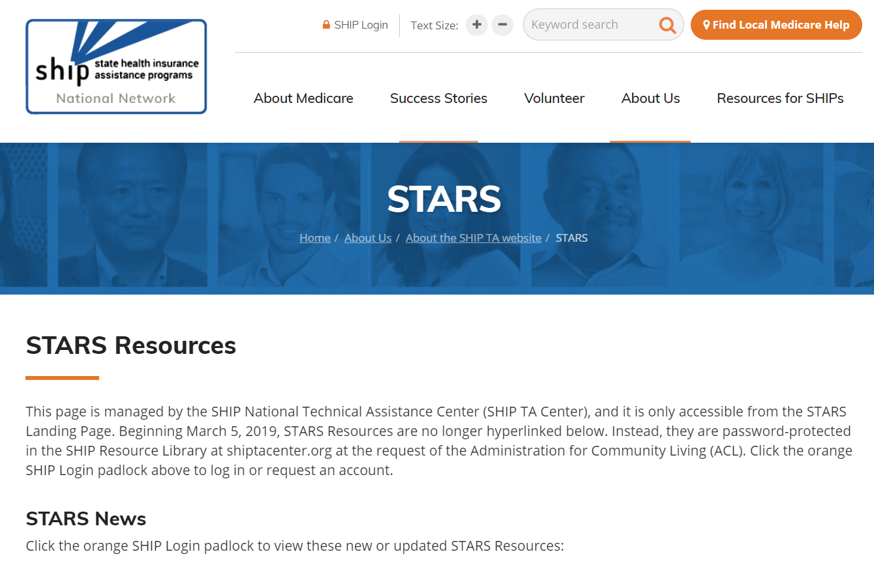
STARS Resources Page
Notes:
SHIP directors and SHIP administrators approve accounts to log into

Slide 42
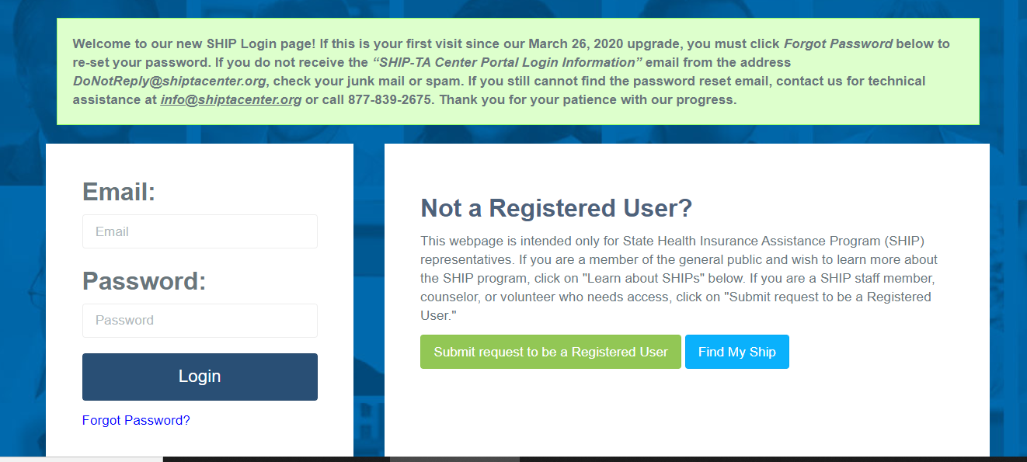
SHIP Login at www.shiptacenter.org
As of March 26, 2020, this is our login page.
  A green banner provides tips for first-time users

Slide 43
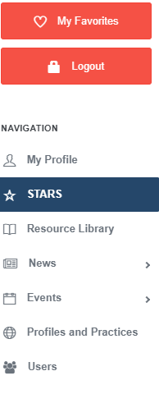
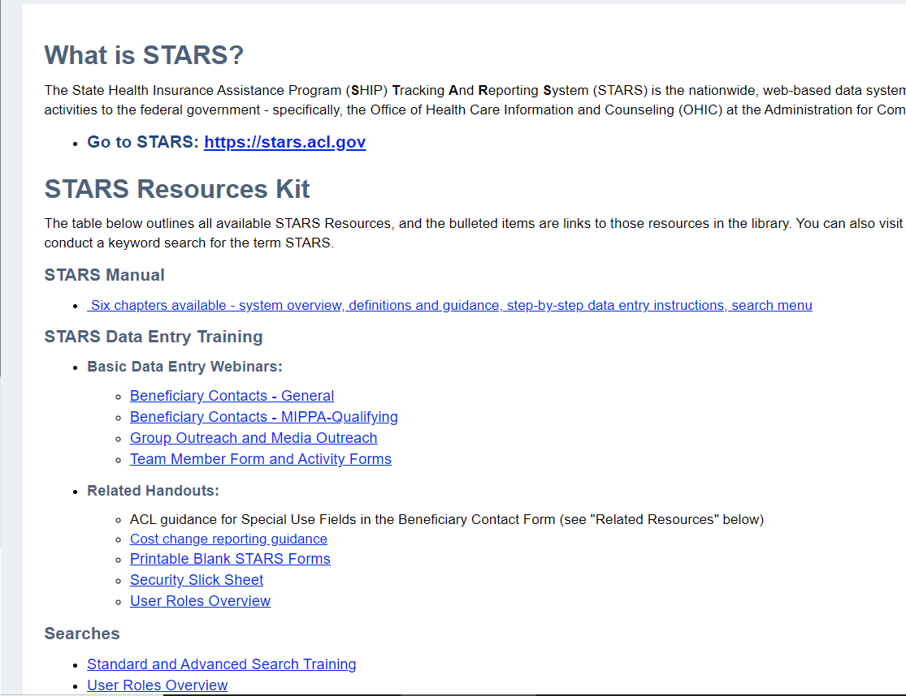
STARS Access and Resources
Notes:
The STARS Resources Kit is now on this STARS menu. Directors and administrators control STARS resources visibility, including access to STARS events.

Slide 44

STARS Manual and Other Resources
STARS Manual:
Chapter 1: Introduction
Chapter 2: User Basics
Chapter 3: Team Member Management
Chapter 4: Beneficiary Contacts
Chapter 5: Group and Media Outreach and Education
Chapter 6: STARS Searches
Handouts, Job Aids and Webinars about:
Reports
User roles
Recordings of past data entry trainings
Notes:
Chapter 1 covers: Programs that use STARS; Data entry due dates; How to get resources and technical assistance.
Chapter 2 covers: STARS address/landing page; Credentials (usernames and passwords); STARS security; STARS inactivity rules; Entering hours on your own team member form
Chapter 3 covers: Creating and Managing Team Members; Using the Activity Form; CMS SHIP Unique ID; Detailed user role descriptions and the impact of the STARS hierarchy
Chapter 4 covers: Beneficiary Contact Form and the Beneficiary Additional Sessions Form
Chapter 5 covers: Group outreach and education (GOE) and media outreach and education (MOE) forms
Chapter 6 covers: STARS Searches vs. STARS Reports, and how to conduct searches.
Use the job aids, handouts, and PPTs for searches, reports, and user role overview.

Slide 45
Appendix B
--NPR-transferred data (slides from June 2019)

Slide 46
NPR-Transferred Data in STARS
All data from NPR was transferred into STARS in June 2019
Migrated to the state-level partner organization
  Only state-level users can access migrated NPR data
All state-level Performance Measure Reports will include NPR data, when applicable
  They are based on zip code, not location of the form in the hierarchy
Users below the state level will not be able to access the data, including the reports, unless the individual forms are reassigned
Notes:
ACL. Talking point. For instructions for reassigning records to other team members, see the end of Chapter 3 of the STARS Manual.

Slide 47
“DoNotDelete NPRData” Team Member
BAH created a team member specifically for the transferred NPR data: Do NOT delete this team member
  First name = DoNotDelete
  Last name = “NPRData” plus your two-digit state abbreviation
    i.e. NPRDataAL (for Alabama, and so on)
This NPR team member appears in “Session Conducted by” fields
If desired, you can manually reassign NPR-transferred records to any other team member at any level of the hierarchy
Notes:
ACL. Talking point (if not already mentioned): for instructions for reassigning records to other team members, see the end of Chapter 3 of the STARS Manual.

Slide 48
Other Elements of “DoNotDelete NPRData”
Date of Birth = 01/01/1950
Gender = Not Collected
Paid Status = Volunteer
Primary Language = Other
Race = Not Collected
Start Date = 01/01/2005
Status = Active
User role = STARS Submitter
Note: Data associated with this team member will appear on the Resource Report
Notes:
ACL.

Slide 49
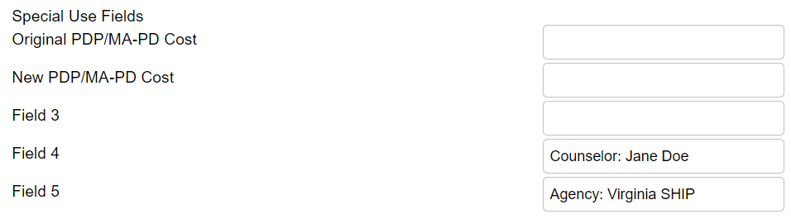
Counselor and Agency Information on NPR-transferred data
Saved to the Special Use Fields
  Counselor name was saved to Field 4
  Agency name was saved to the Field 5
Example from the Beneficiary Contact Form:
Notes:
The special use fields also appear on the Group Outreach and Education form and the Media Outreach and Education Form.

